Slide 1



European Rally & European platform
Charlotte De vos
IIW Past President

Slide 2
European Rally

Slide 3
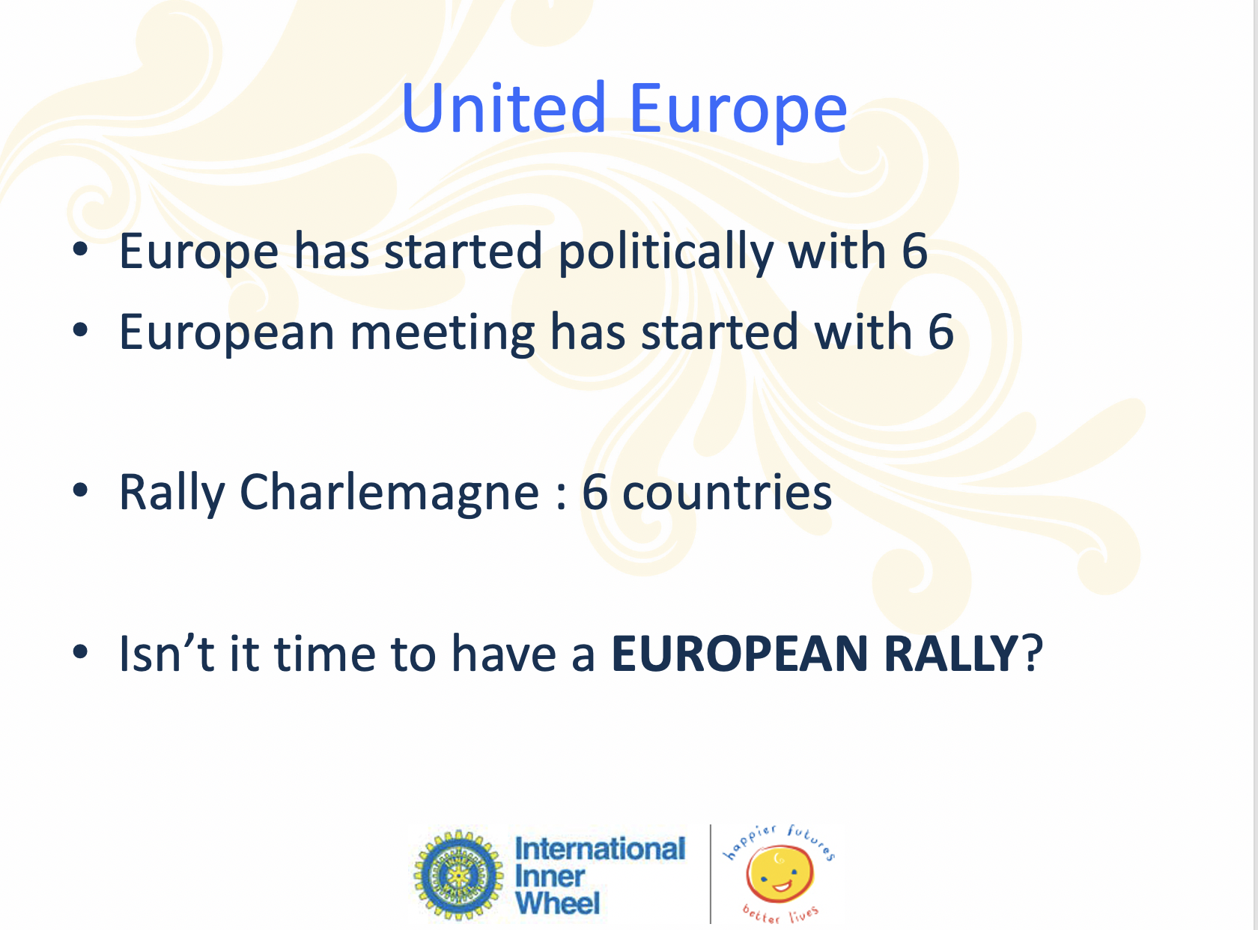
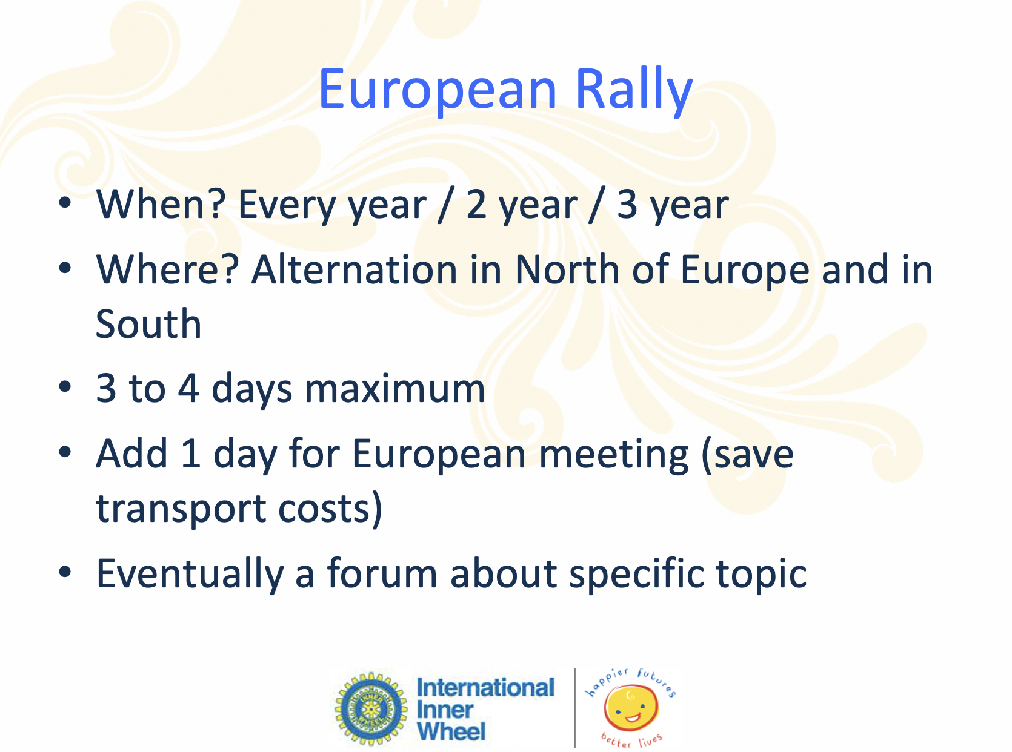


EM Varese 2016 - a United Europe

Slide 4
Rotterdam 2019
Planned as 14th Rally Charlemagne with 6 countries
And became
1st European Rally open to all European countries
With symposium Move to connect
Thank you IW Nederland

Slide 5
Future Organisation
2022 = Berlin
2025 = ?
Should be known in 2022
2 years to go for EM to work on a procedure

Slide 6
European Platform

Slide 7
Possibilities
Website of IW Europe
Social media : Facebook
Inner Wheel European Platform Group
Inner Wheel Europe page

Slide 8
IW Europe website
  1. To centralise interesting documents as
- Training documents
- Presentations on different events
- archive of reports as NR reports….
2. To give opportunity to smaller countries who have no website to be visible on the web

Slide 9

FB Inner Wheel European Platform
CLOSED group

Slide 10
Objectifs = discussions
Not to say hello, send flowers, birthdaywishes etc…
Who wants to join has to mention their
Club / District / Country
But majority doesn’t

Slide 11
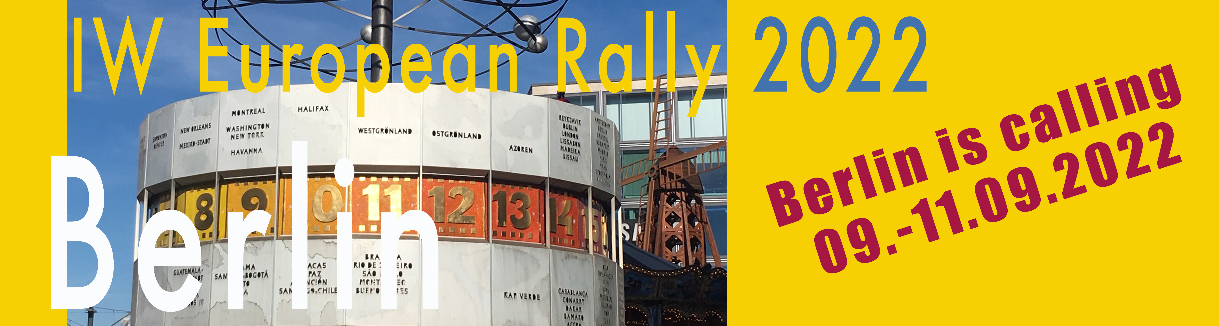
Inner Wheel Europe page
Open to all members
To promote IW activities of European countries

Slide 12
Need your HELP !
Rome has not been build in one day
Who wants to help me and administrate the group and page
One by country? Who ?
It is up to you
Please feel free to contact me

Slide 13
Thank you

