Slide 1


Slide 2



Slide 3
3 WORKSHOPS
FAMILY(Coordinator:Hannele Karhunen ,IIWpBD ,Finland)
1. Domestic violence. Children as victims or witnesses of abuse.
2. Children and families in adverse life situations
3. Children with special educational needs
JOB(Coordinator:Hildegund Scheipermeier,IIW pBD,Germany)
1. Child labor. Breaking into the…fairytale.
2. Child trafficking and child pornography.
3. Child labor conditions. Impact on mental and physical health.
CULTURE & SOCIETY(Coor.:Roz.Nikolakopoulou,IIWpBD,Greece)
1. Unaccompanied children refugees in Europe. Their integration as
citizens in a multicultural environment.
2. The contribution of art to the all-round development of children.
3. Preventing bullying and cyber bullying across Europe.

Slide 4

Women for Europe 9
OPENING CEREMONY

Slide 5
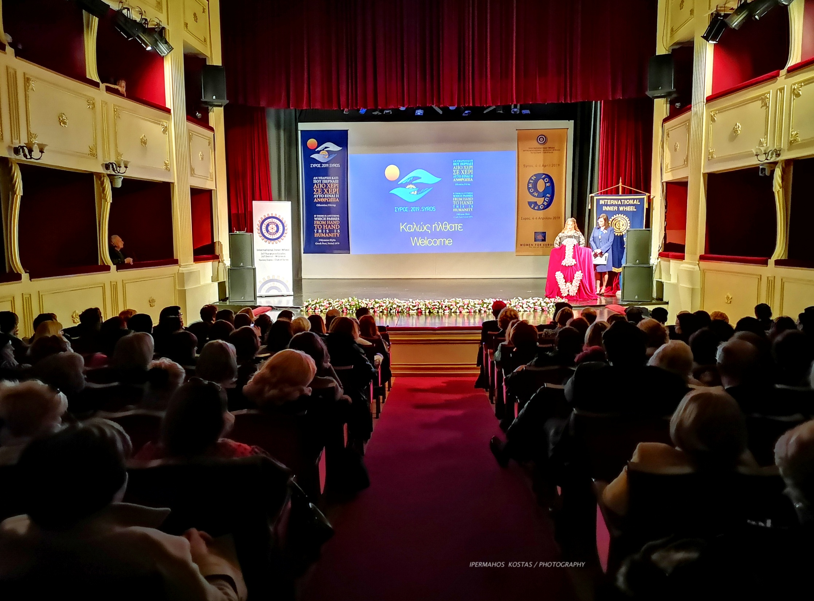
OPENING CEREMONY

Slide 6
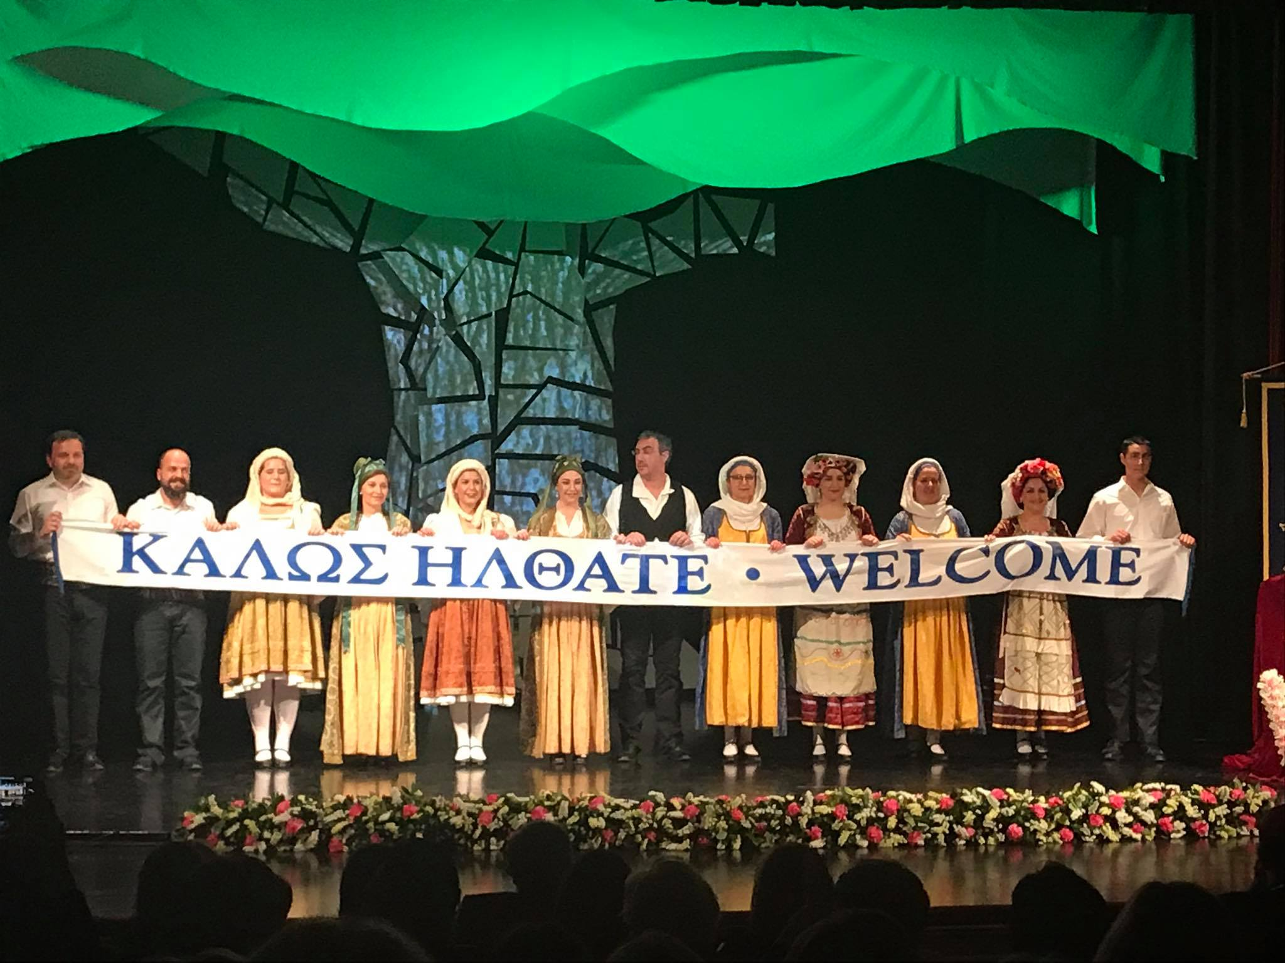
OPENING CEREMONY

Slide 7
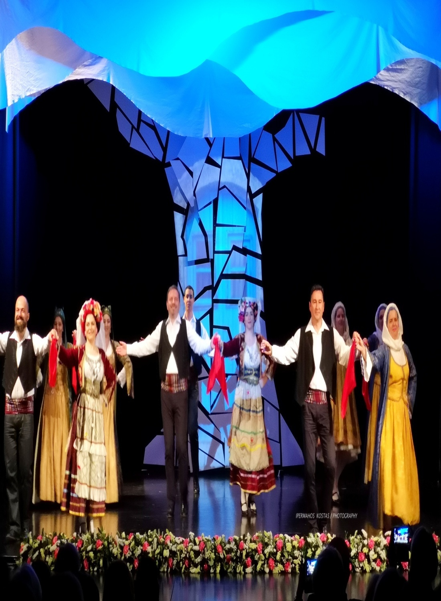
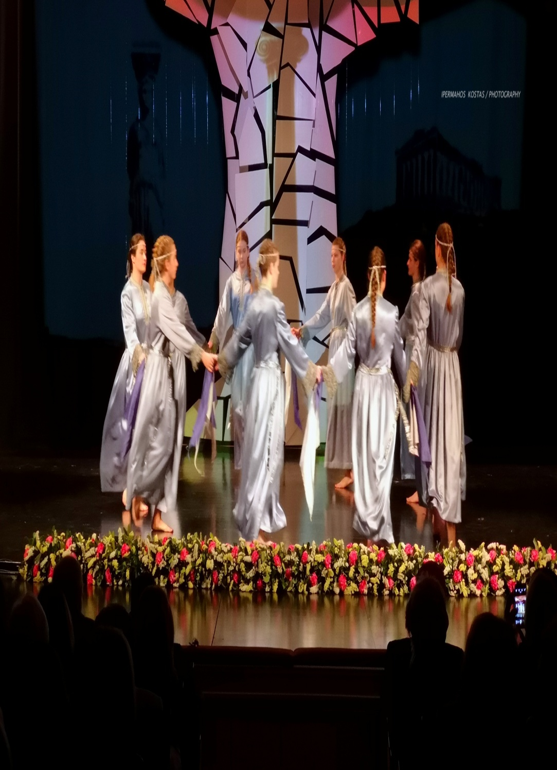
OPENING CEREMONY

Slide 8
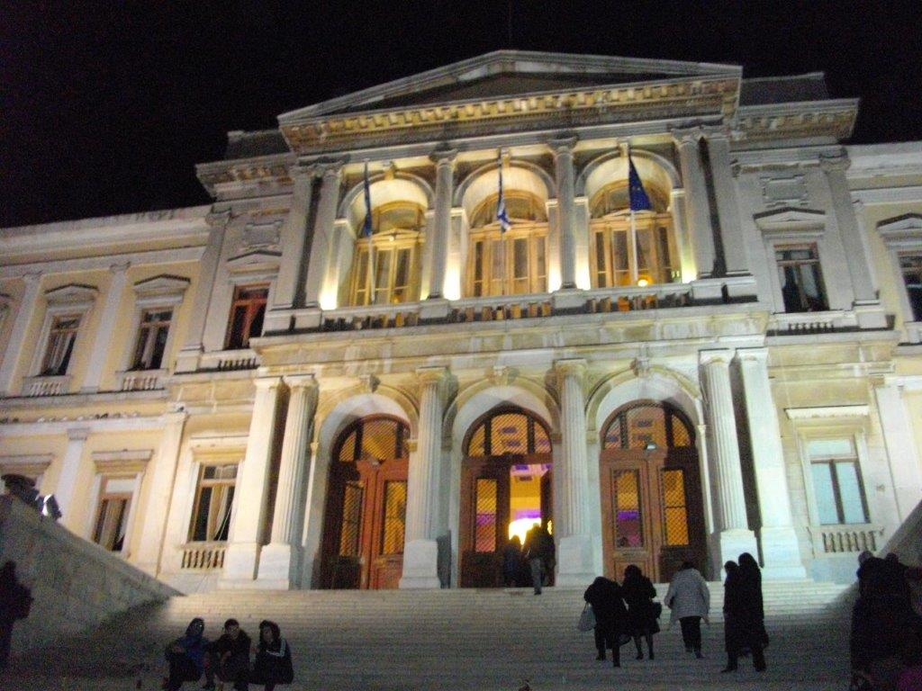
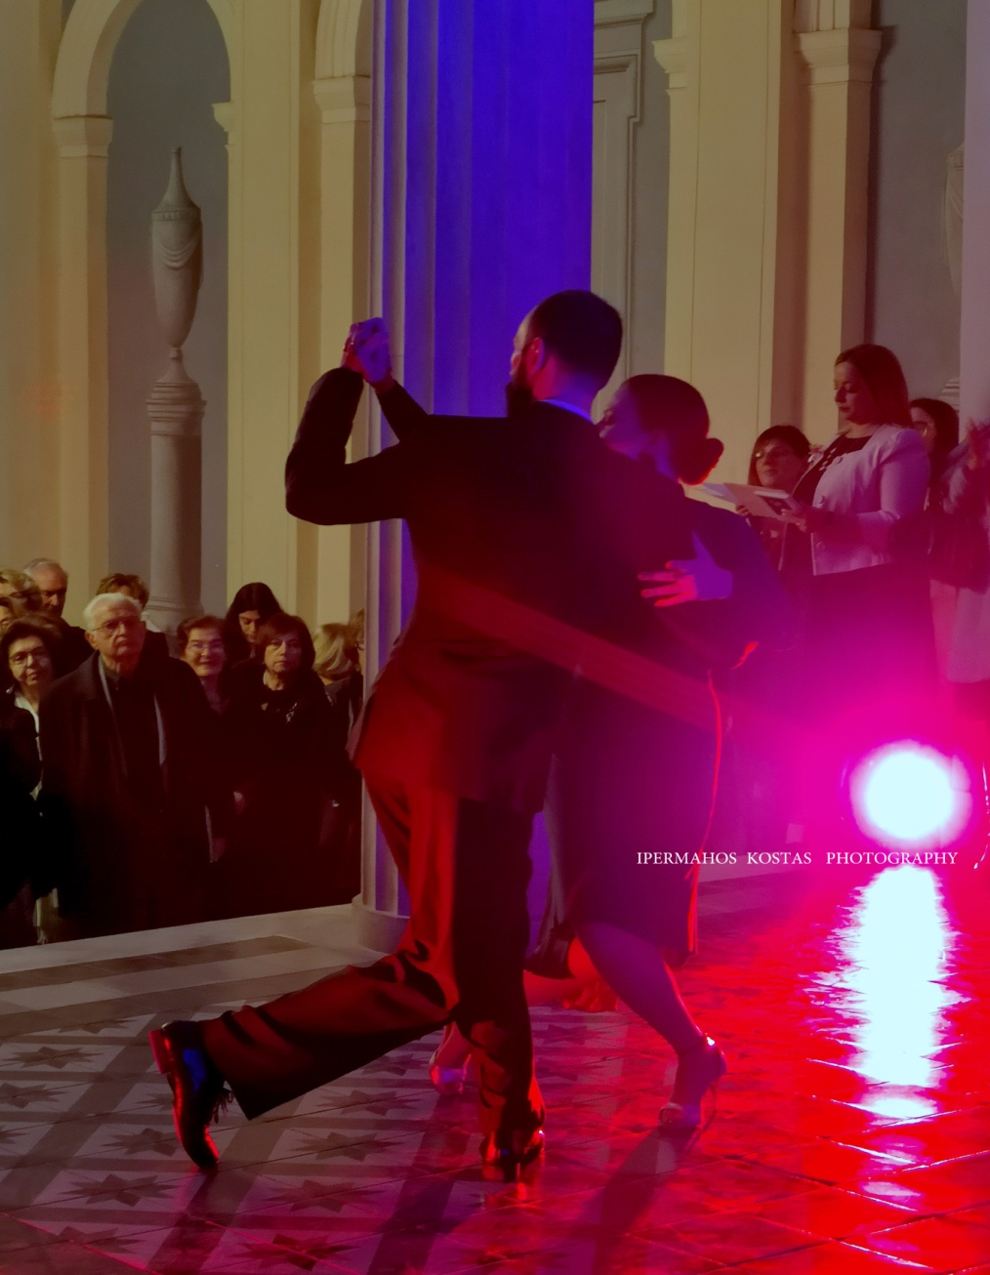
TOWN HALL OF SYROS – GALA DINNER

Slide 9
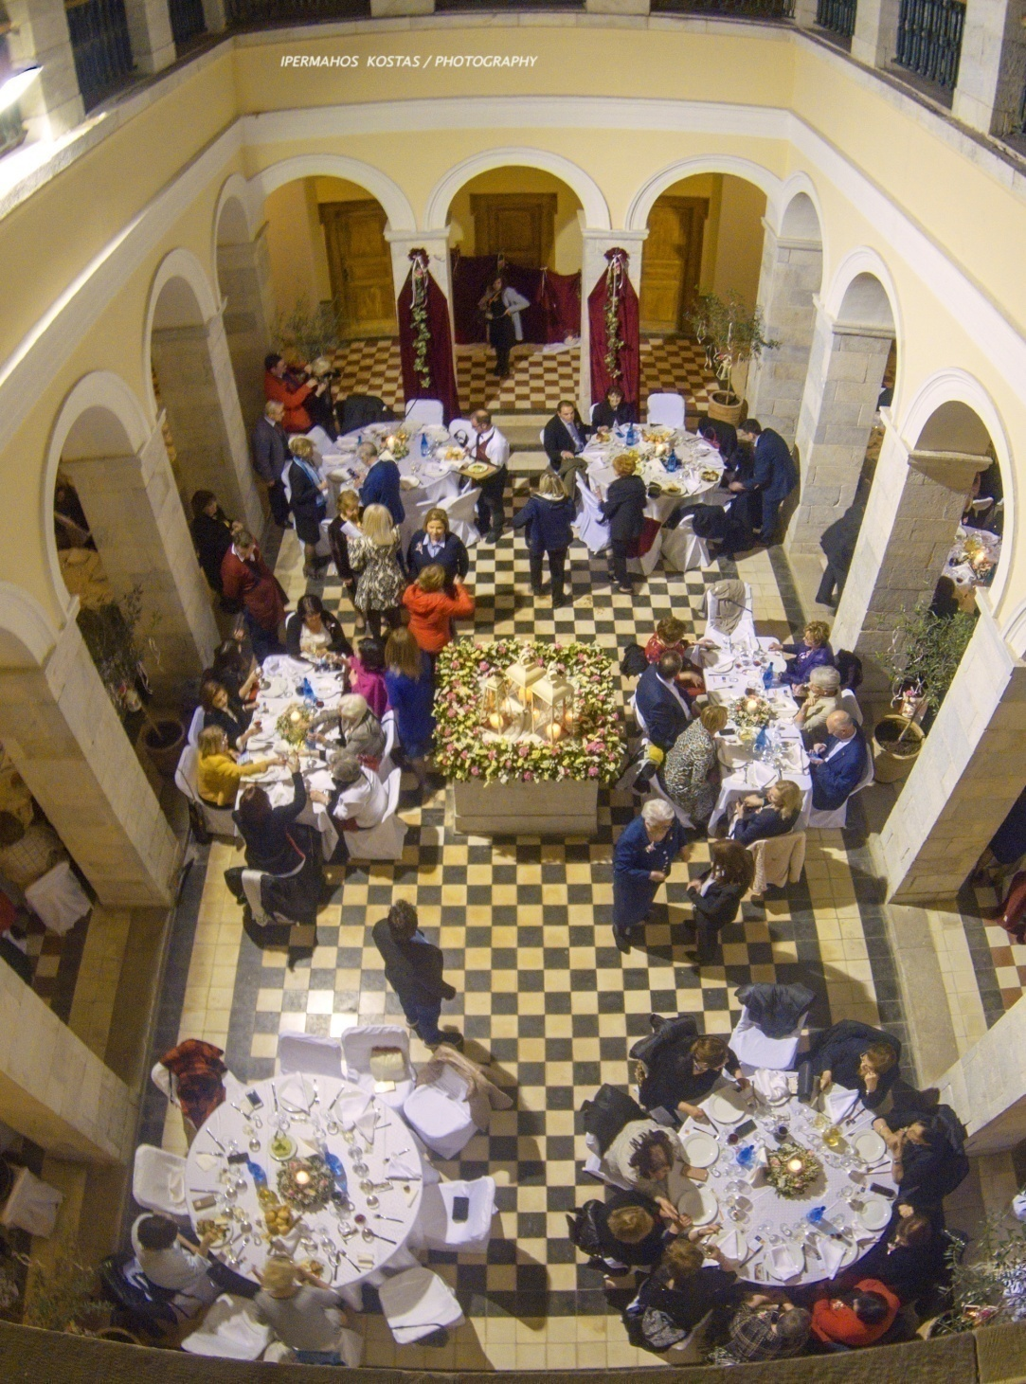
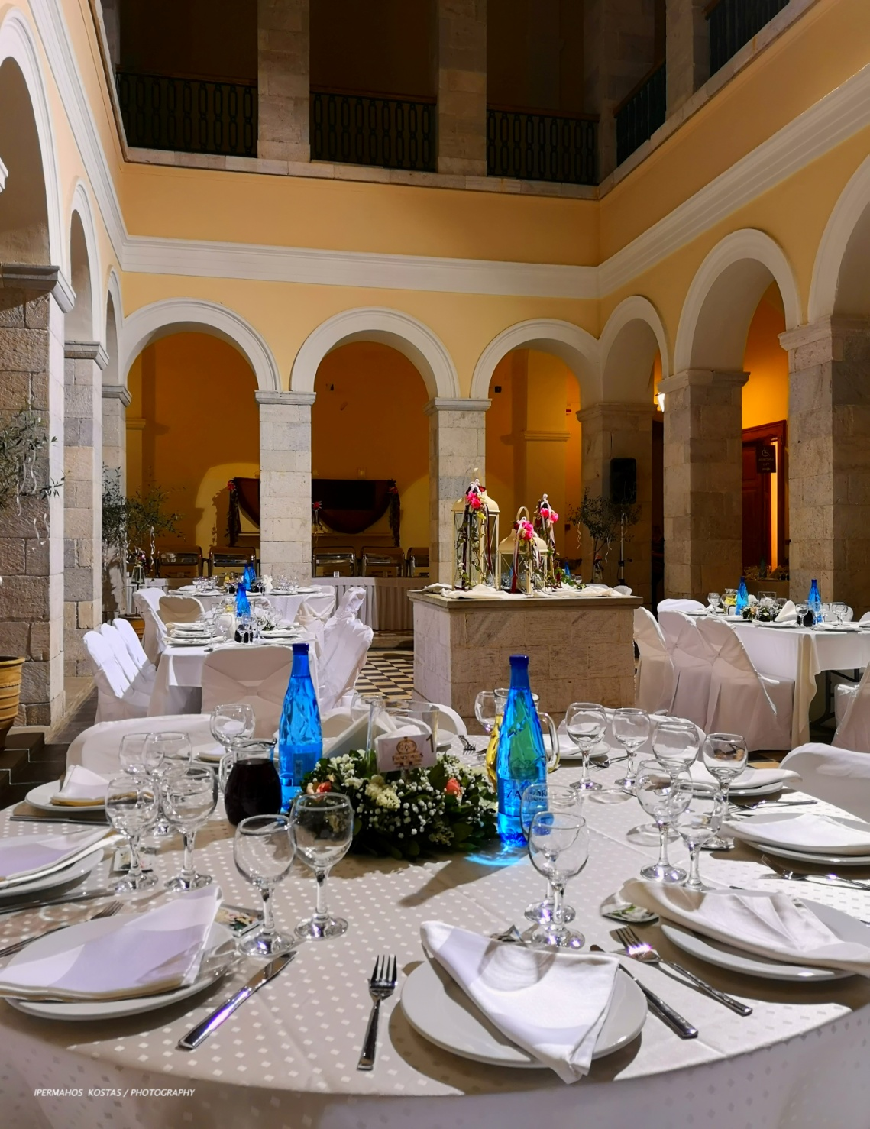
TOWN HALL OF SYROS – GALA DINNER

Slide 10
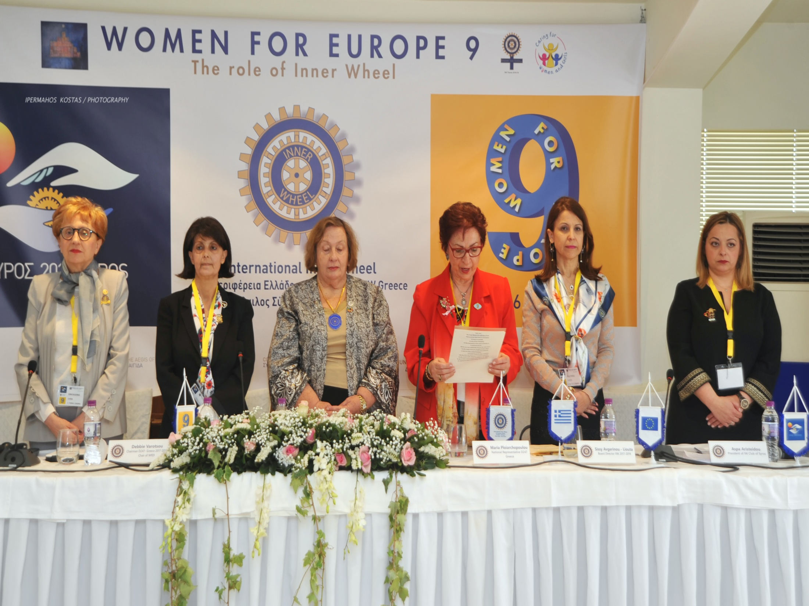
THE CONFERENCE ( 1st DAY)

Slide 11
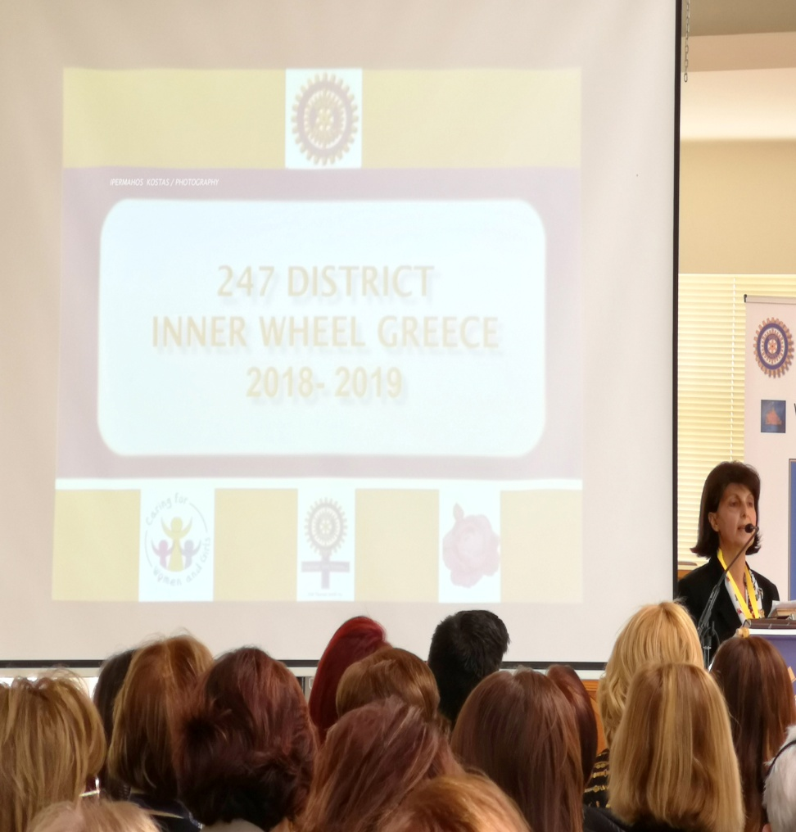
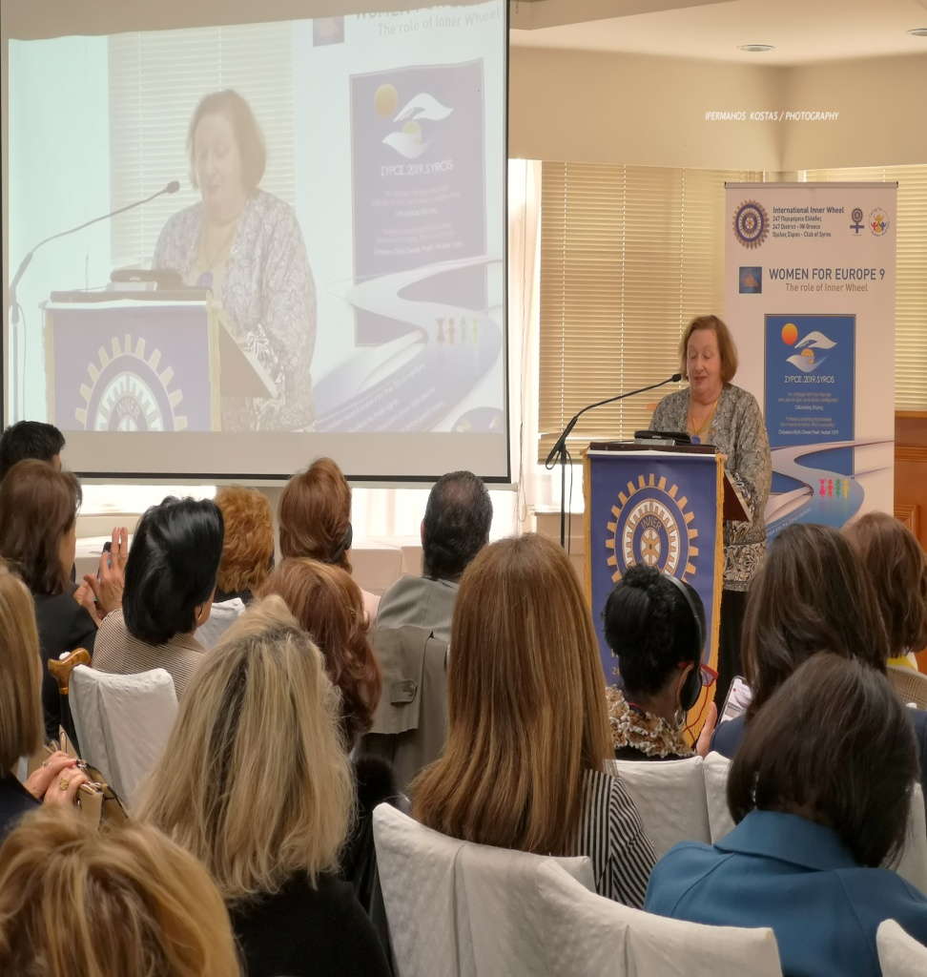
OPENING GREETINGS-SPEECHES

Slide 12
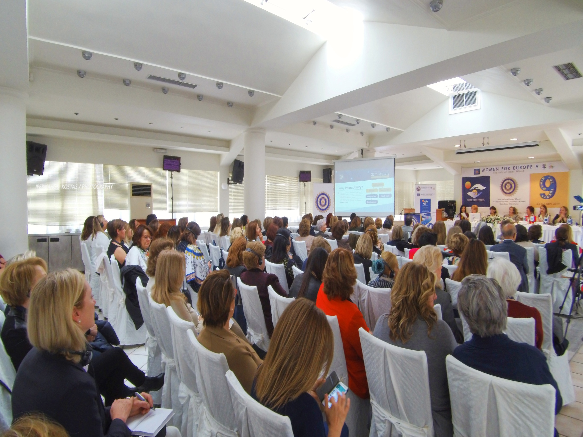
PLENARY SESSION

Slide 13
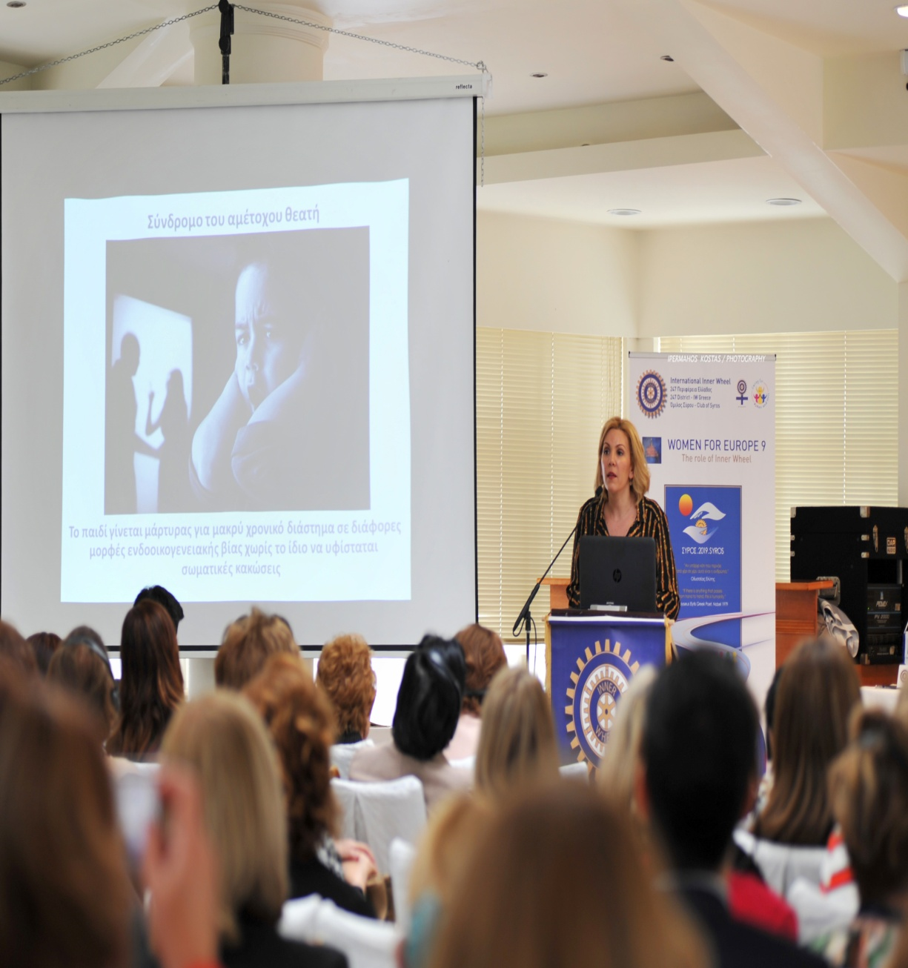
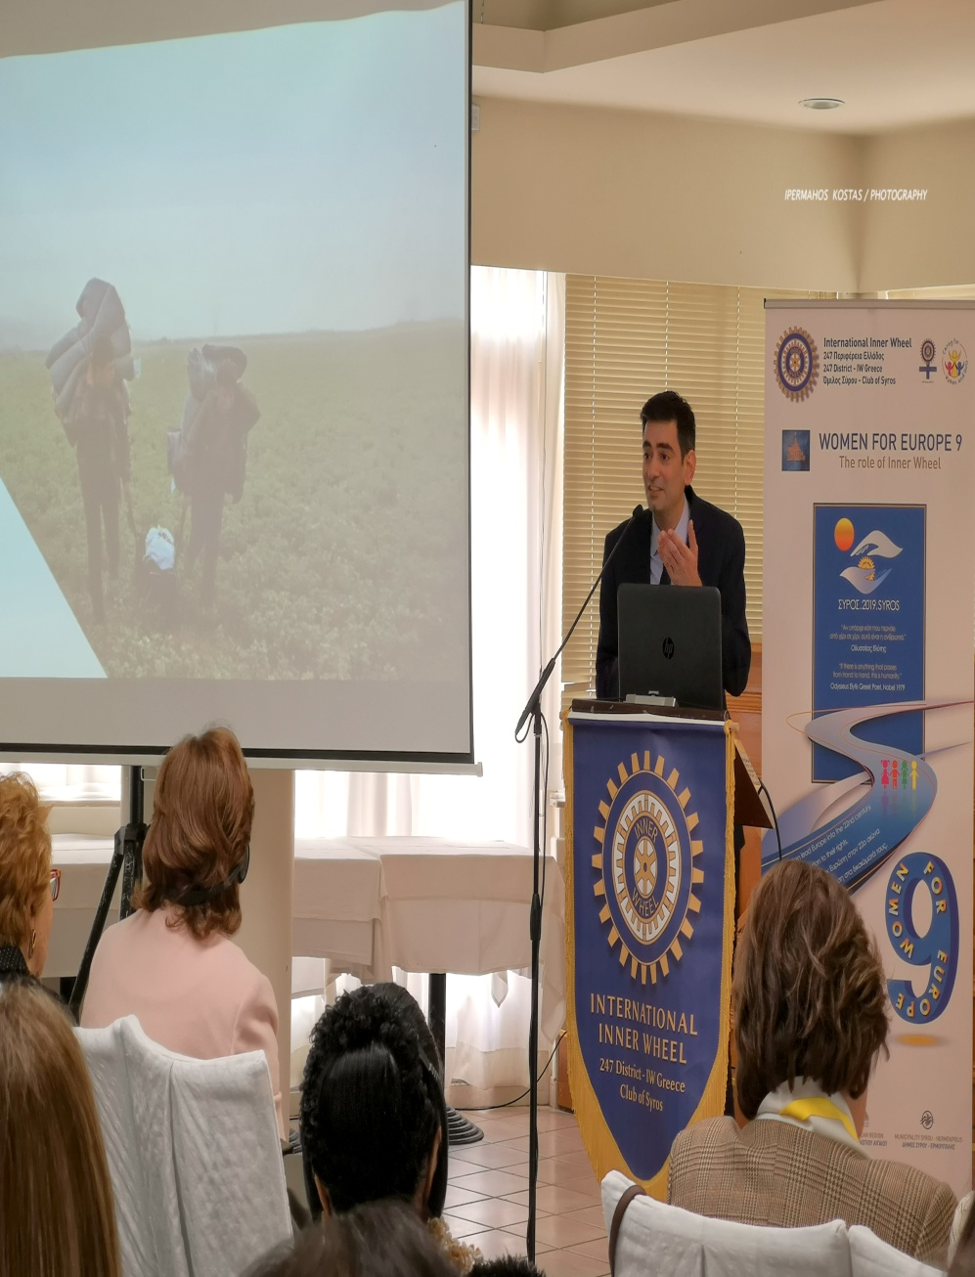
KEY NOTE SPEAKERS

Slide 14
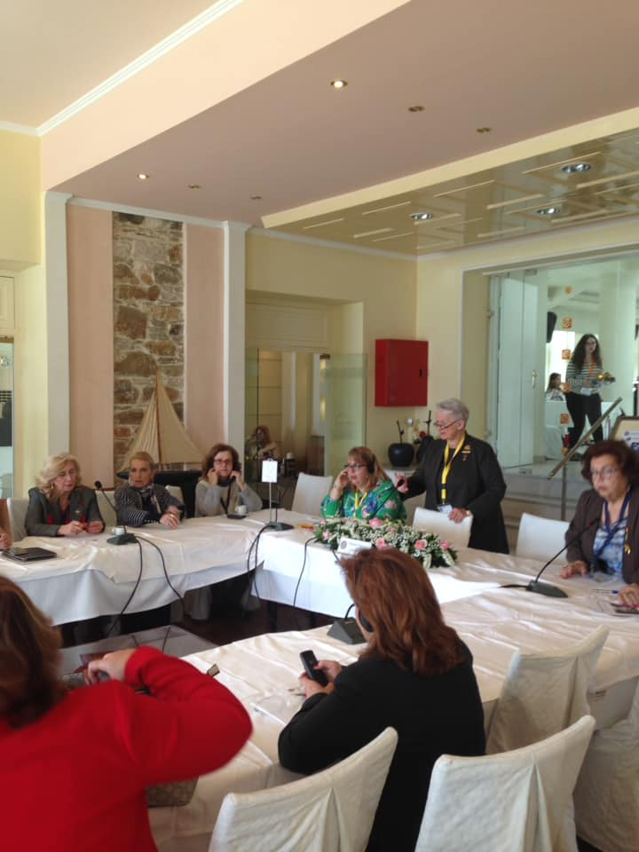
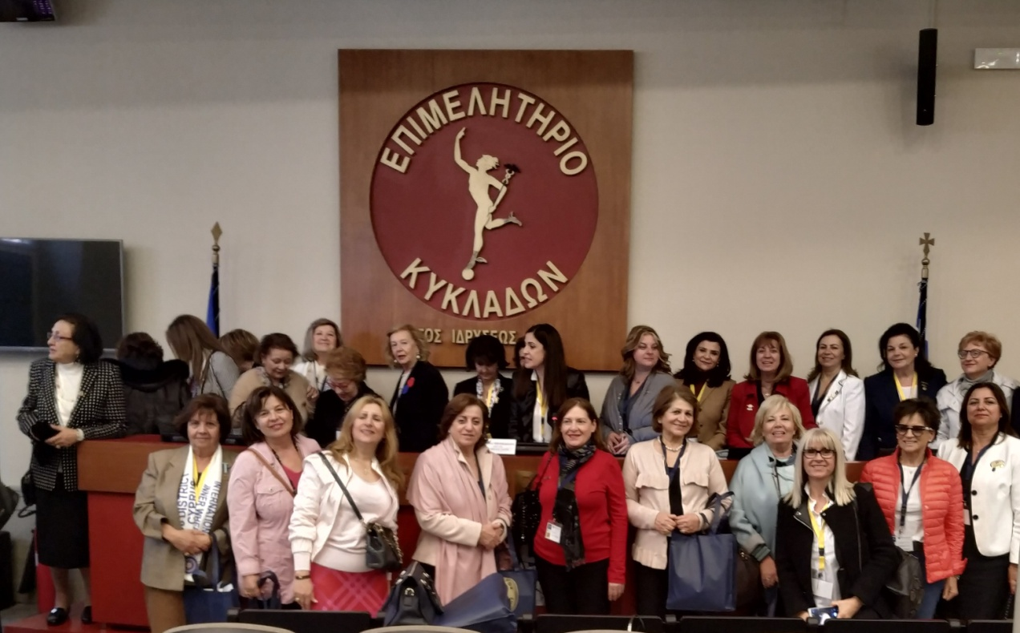
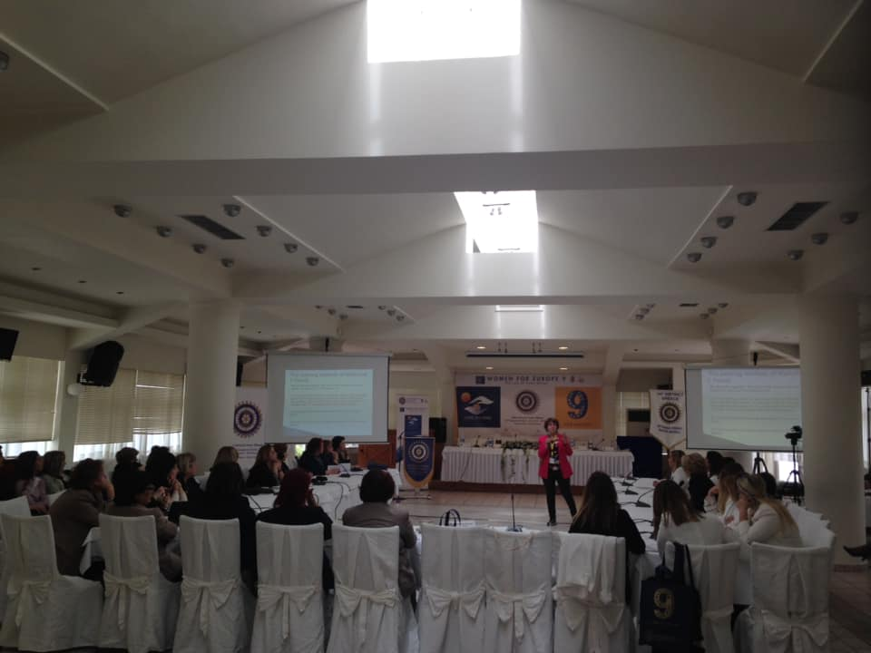
WORKSHOPS

Slide 15
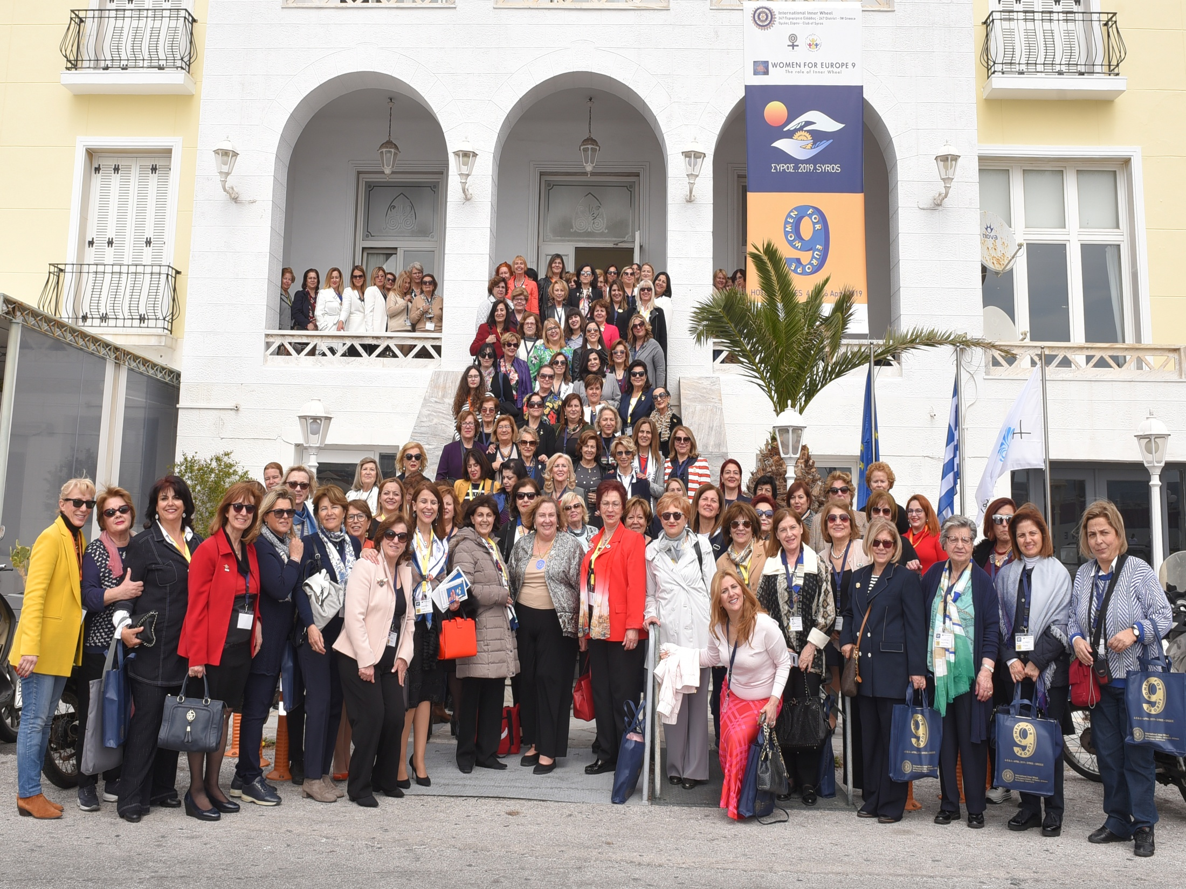

Slide 16
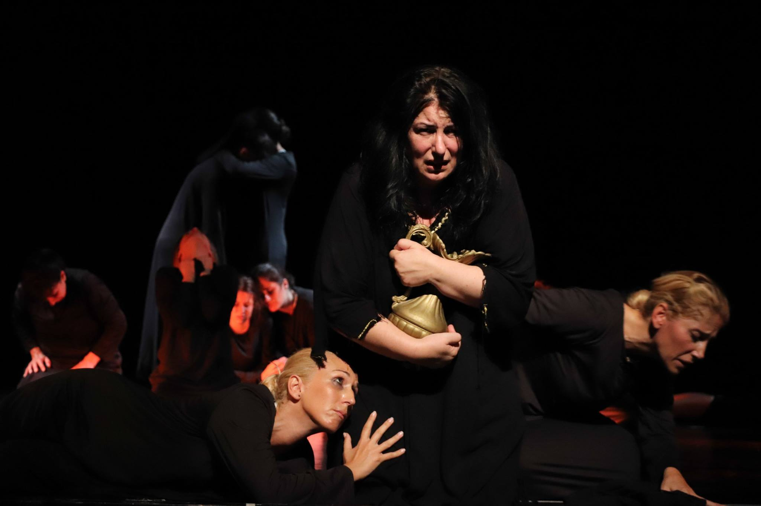
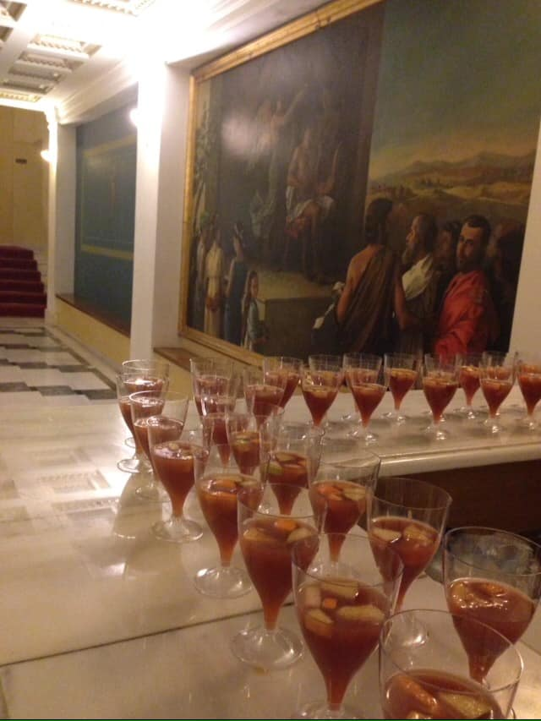
Ancient Tragedy Cocktails at the
“Electra by Sophocles” theatre’s foyer

Slide 17
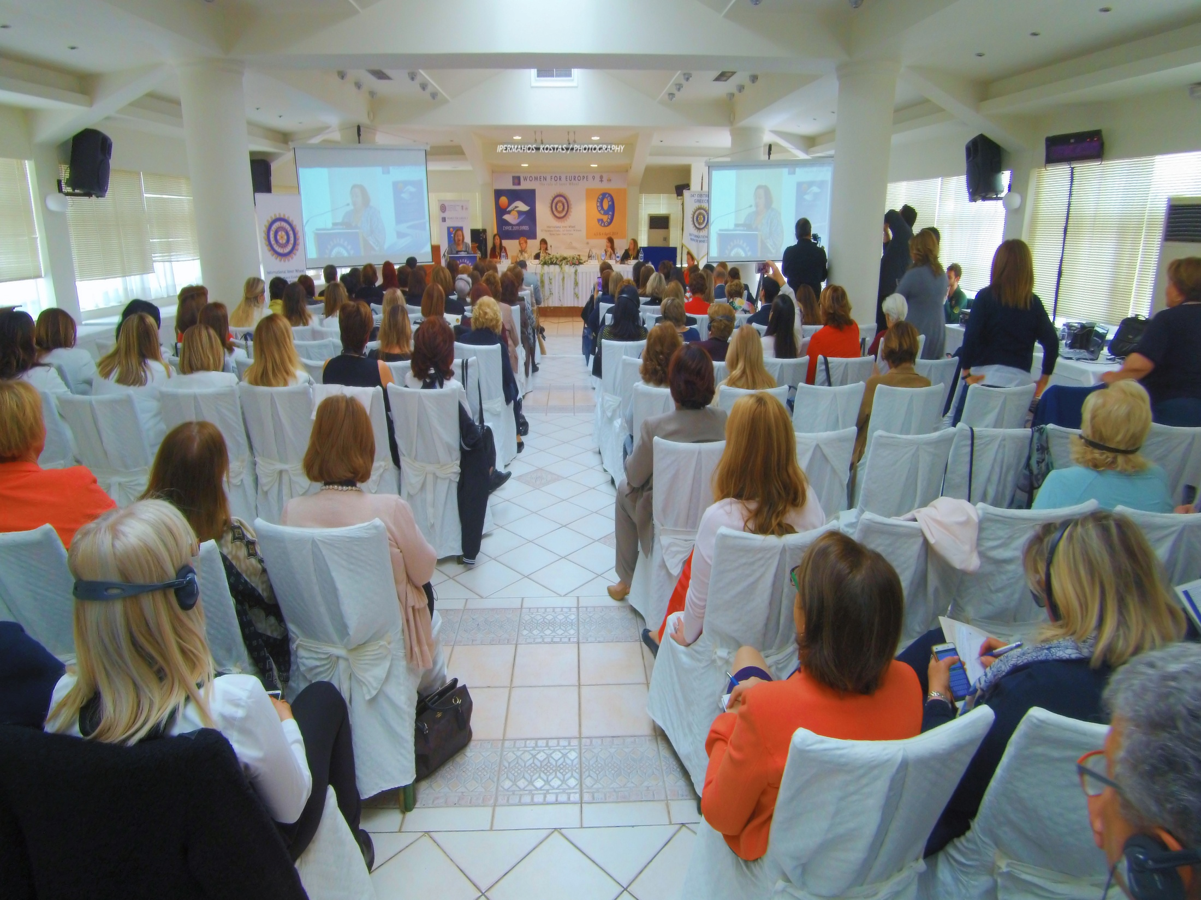
CONFERENCE – 2ND DAY
“Final Conclusions”

Slide 18
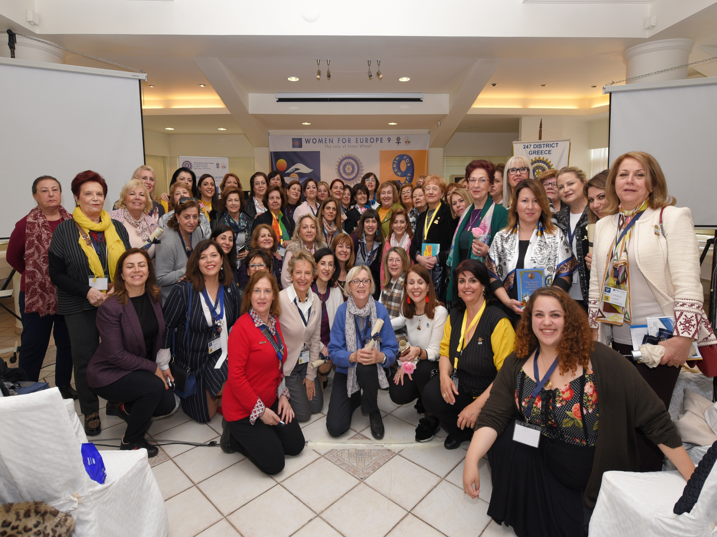
CONFERENCE – 2nd day

Slide 19
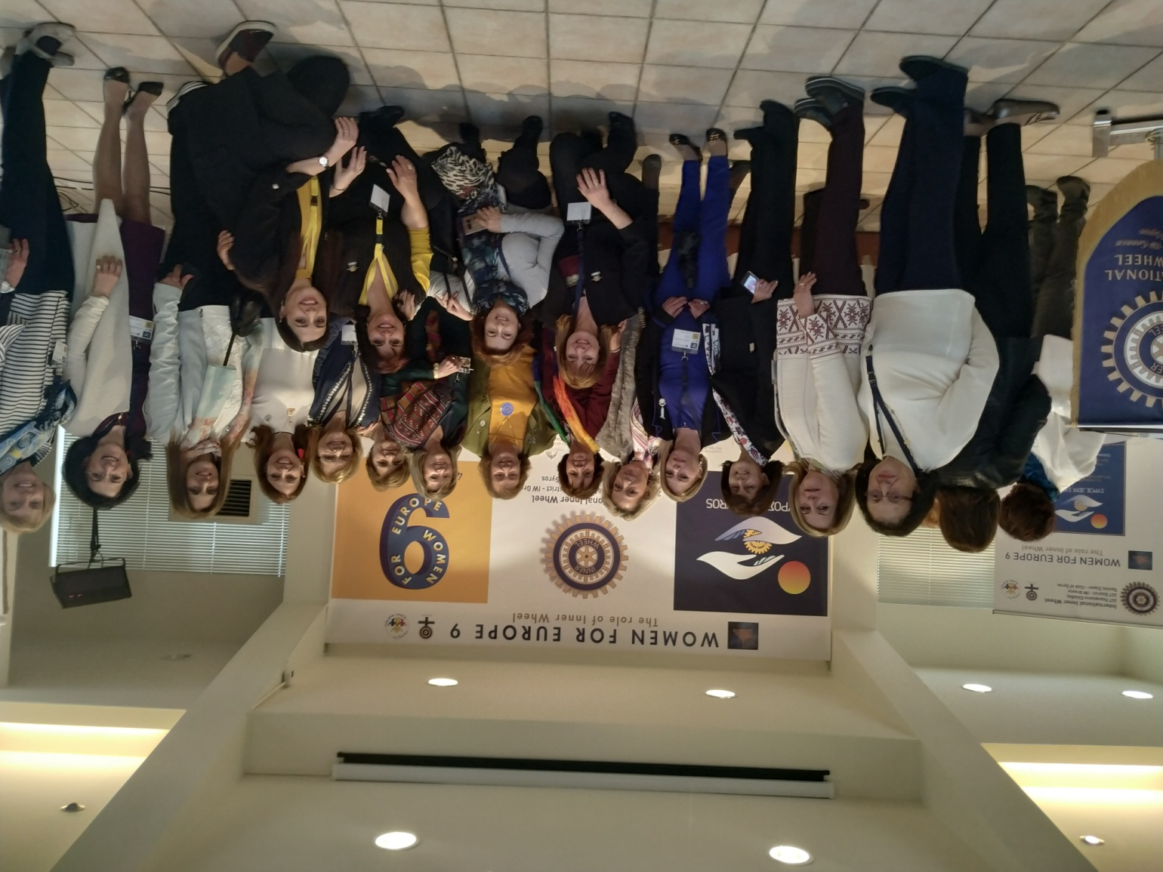
CONFERENCE – 2nd day

Slide 20
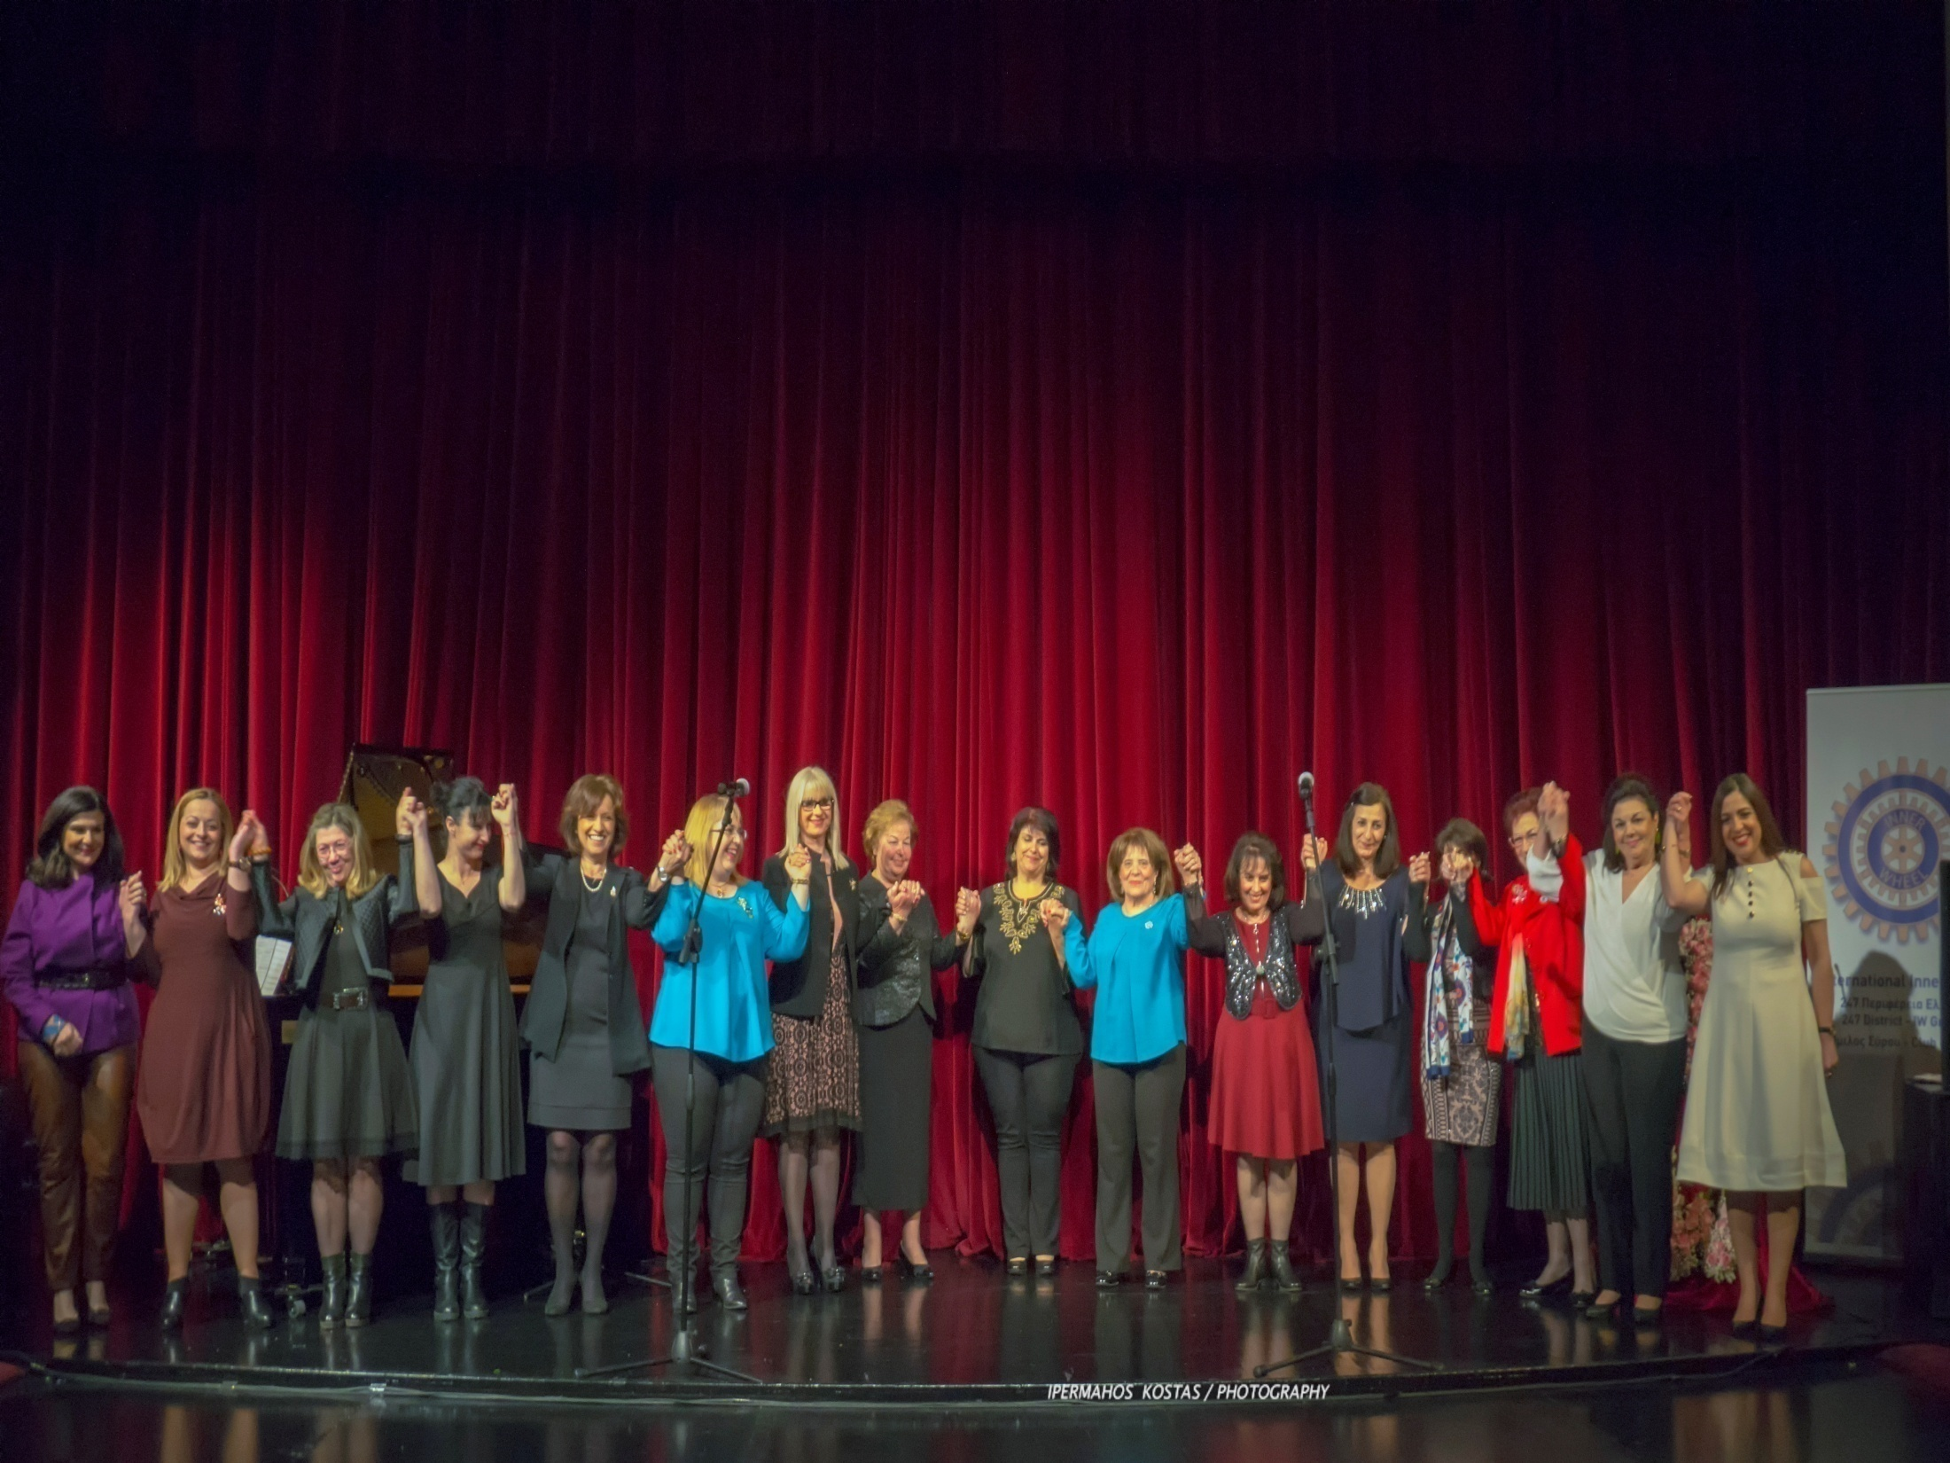
Closing Ceremony
Organising Committee of WfE9

Slide 21
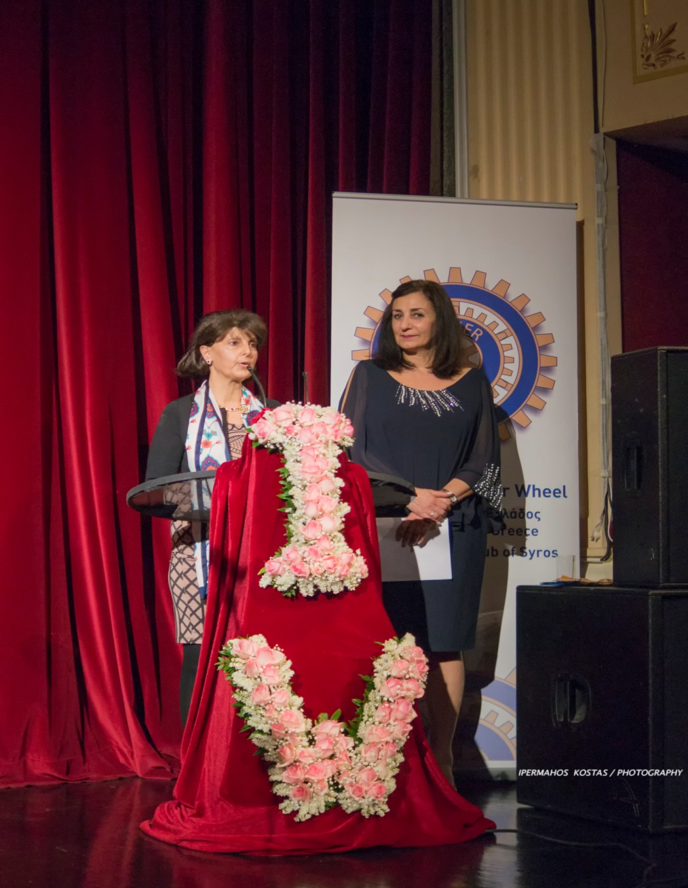
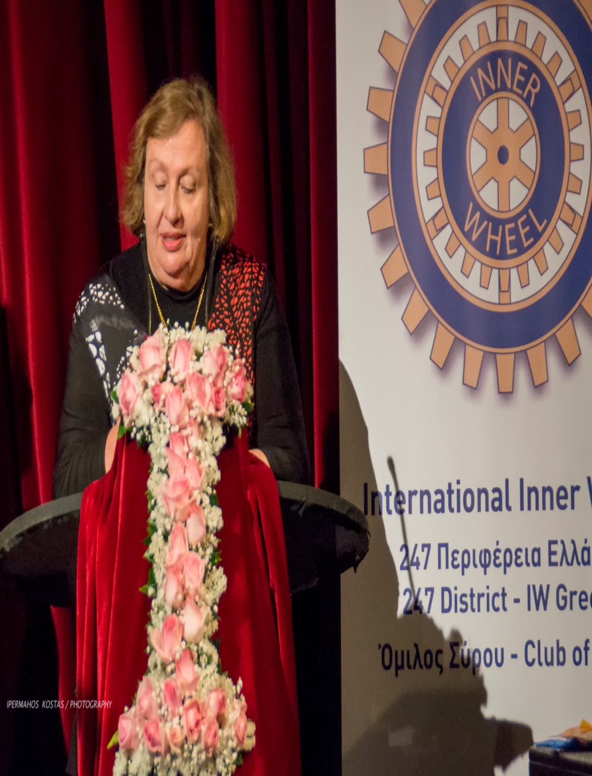
Closing Ceremony

Slide 22
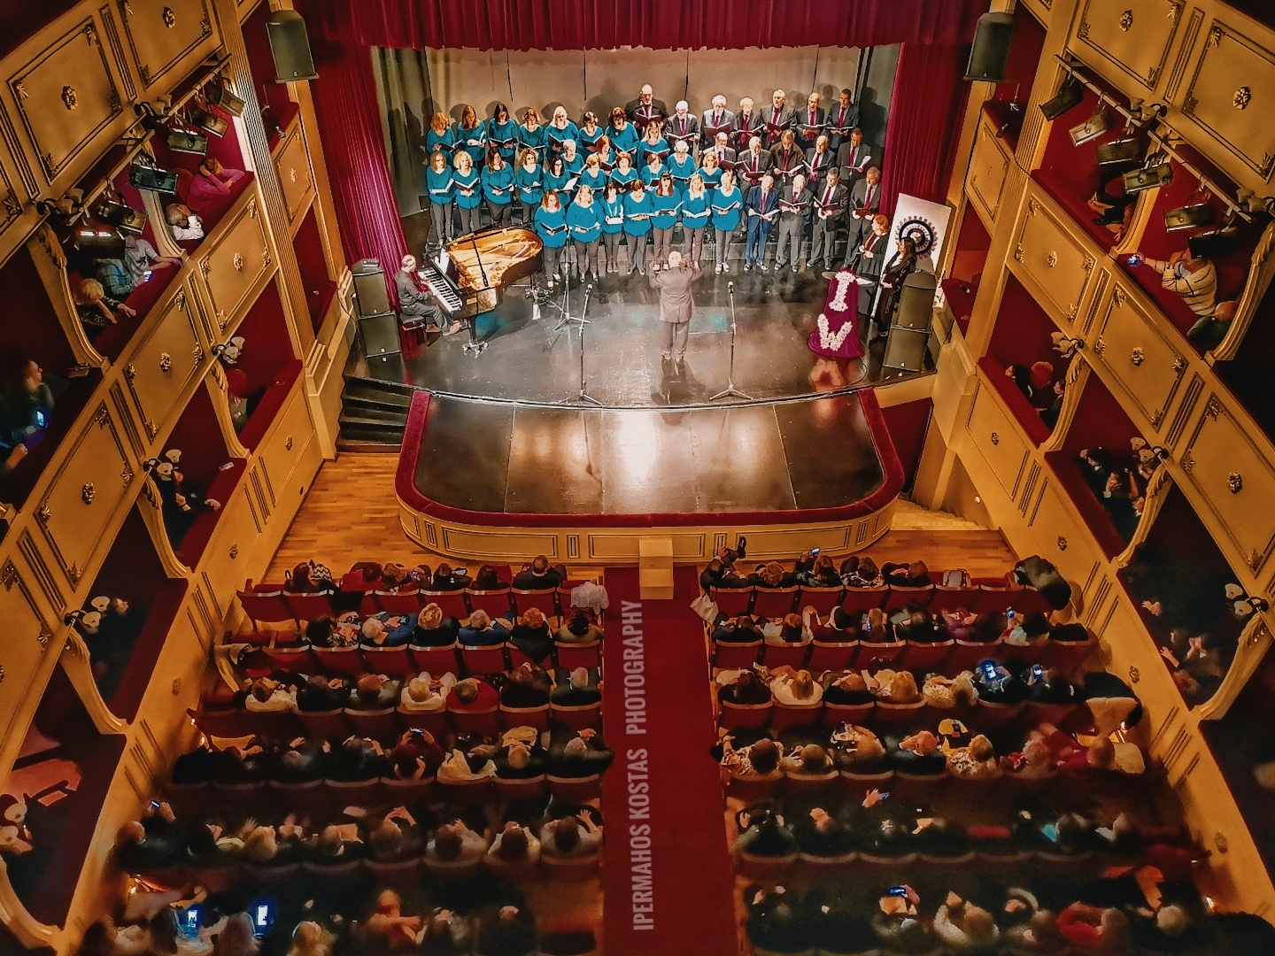
Closing Ceremony

Slide 23
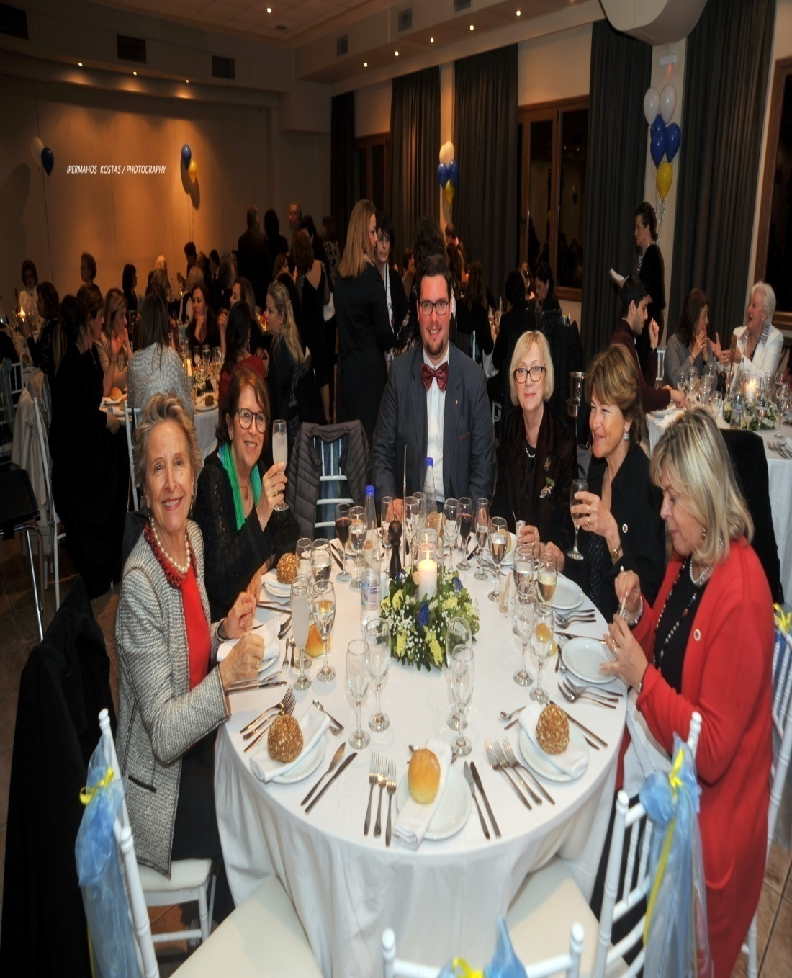
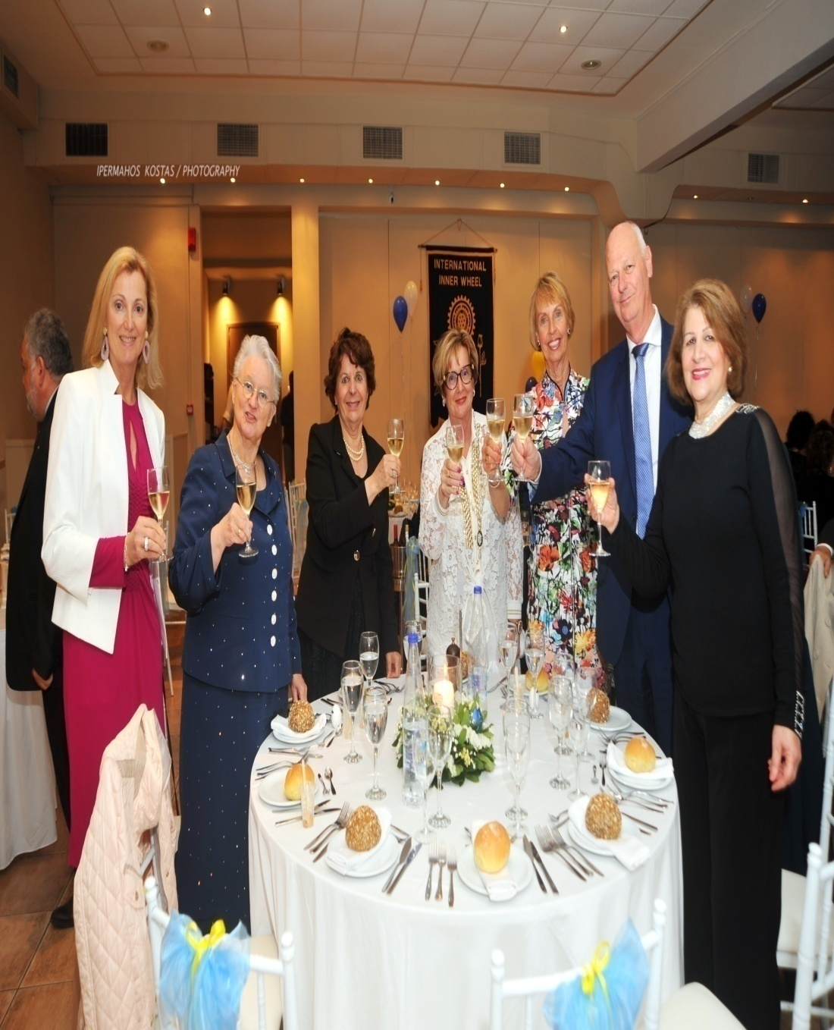
Gala Dinner “Greek night”

Slide 24
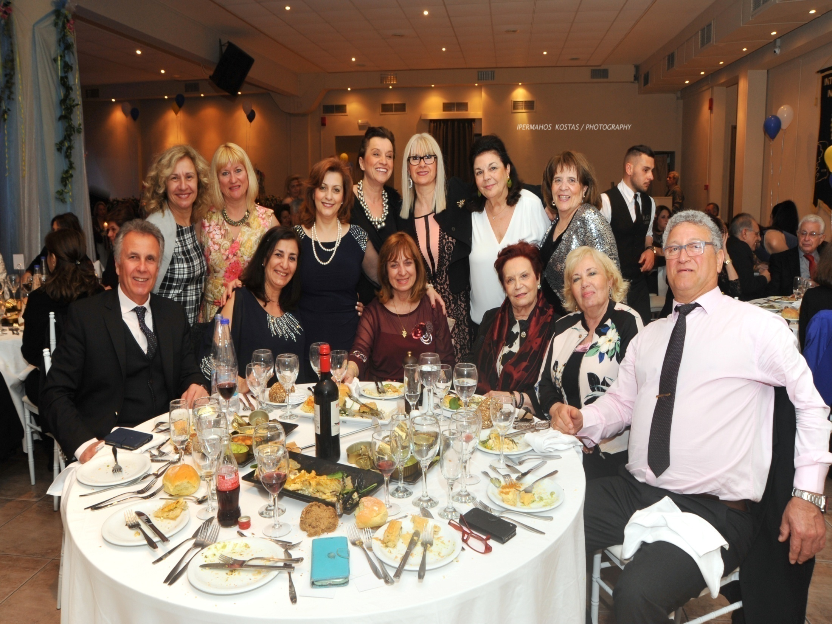
Gala Dinner

Slide 25
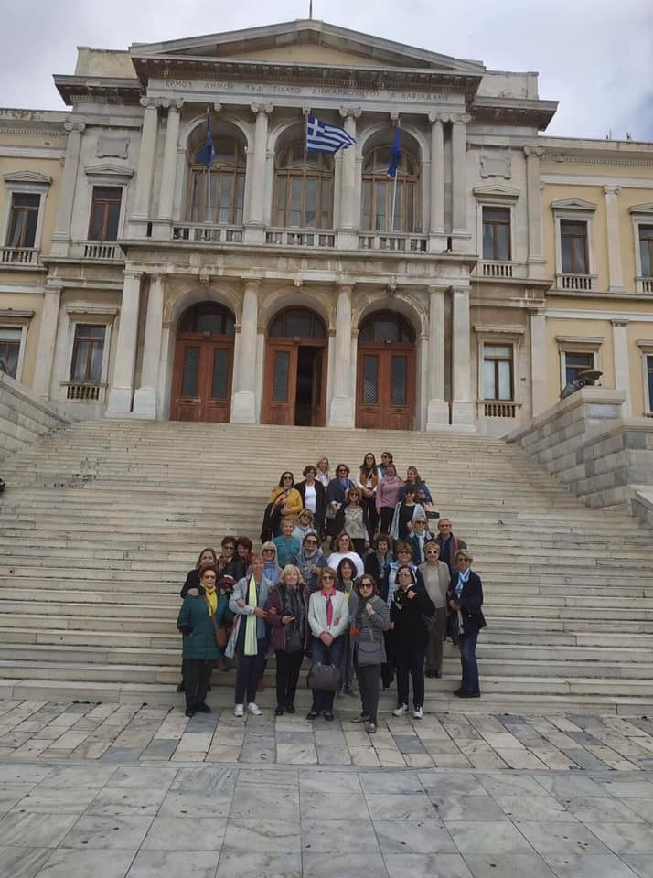
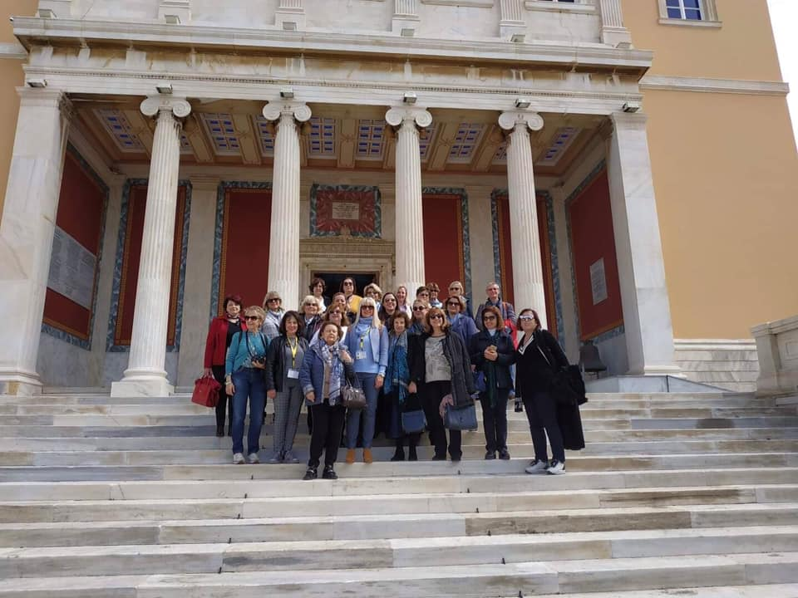
Guided Tours

Slide 26
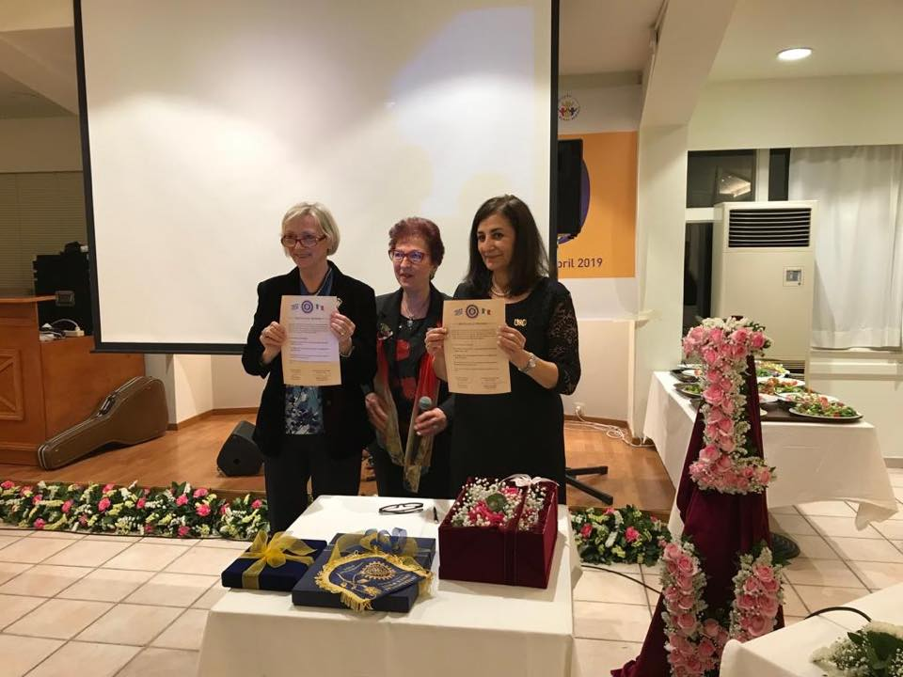
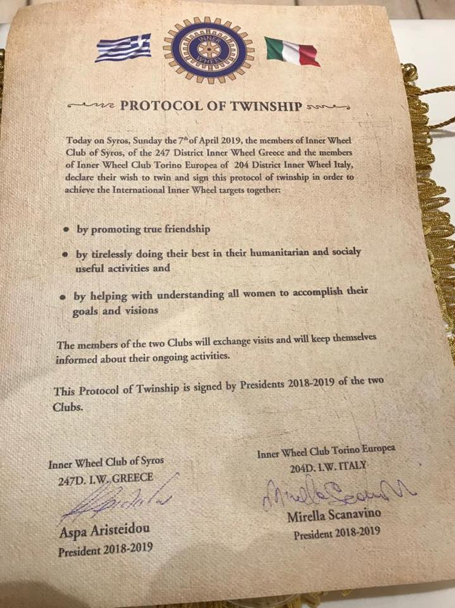
Twinship Ceremony

Slide 27

Notes:
PRESENTATION IN 13th E.M.2019-MUNSTER
YIANNA GRAVIA KALYVA,D.N.R.2019-2020 247 D. GREECE

