Slide 1
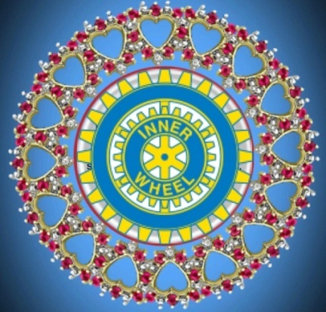
13th European Meeting Münster 9th to 12th September 2019
Contents
District 199 Switzerland/FL
Two main problems in District 199
The Inner Wheel Spirit

Slide 2
District 199
2 Countries
4 Languages
1 District
43 Clubs
1800 Members
Switzerland: 26 Cantons, 26 different school systems, 26 differnt tax systems….
It‘s called : FEDERALISM

Slide 3
Two main problems in CH/FL
How to find new members?
How do you motivate ladies to take a duty?

Slide 4
Finding new members
Constant search for new members whether in Rotary clubs, families, girlfriends
Integrate new members
Preserve and share traditions in the club
Forming an admission committee, which consists of, for example: two older and two younger ladies over several years.

Slide 5
Link the generations
New members should be well integrated
Traditions and customs of the club should be passed on further

Slide 6
Why hesitate to take a duty….
There are so many club members...but nobody wants or can take a duty.... Why?
Reasons WHY it is not possilbe…:
No time
The grand childern, the husband…
I am not able to fit as a president
I cannot talk in front of people
I can‘t do this…..

Slide 7
What is the most important end of the Inner Wheel year?
There's no qualifying interview at the end of the year, no raise
No one demands more dividends
WHAT do we remember?
Only the good mood
the laughter, perhaps sad moments, beautiful excursions and interesting lectures

Slide 8
What can be done?
Anyone can get involved
It is important:
to talk together
to ask
to help each other
to be confident
The wheel does not have to be reinvented

Slide 9
Working in team!
The club is not the president!
All members make up a club!

Slide 10
The Spirit of Inner Wheel?

Slide 11
To foster true friendship
Friendship is like a lighthouse
You can see it clearly when it's light, but its true purpose is only revealed when it shines through storm and darkness.

Slide 12
Catherine Ineichen-Flueler, NR 2019/2020 District 199 CH/FL Münster Germany Sept. 19

