Slide 1
Inner Wheel Sweden
Inner Wheel Sweden in a nut shell
Ups & downs, but looking forward
Margareta Wesslau, National Representative 2017-2018

Slide 2
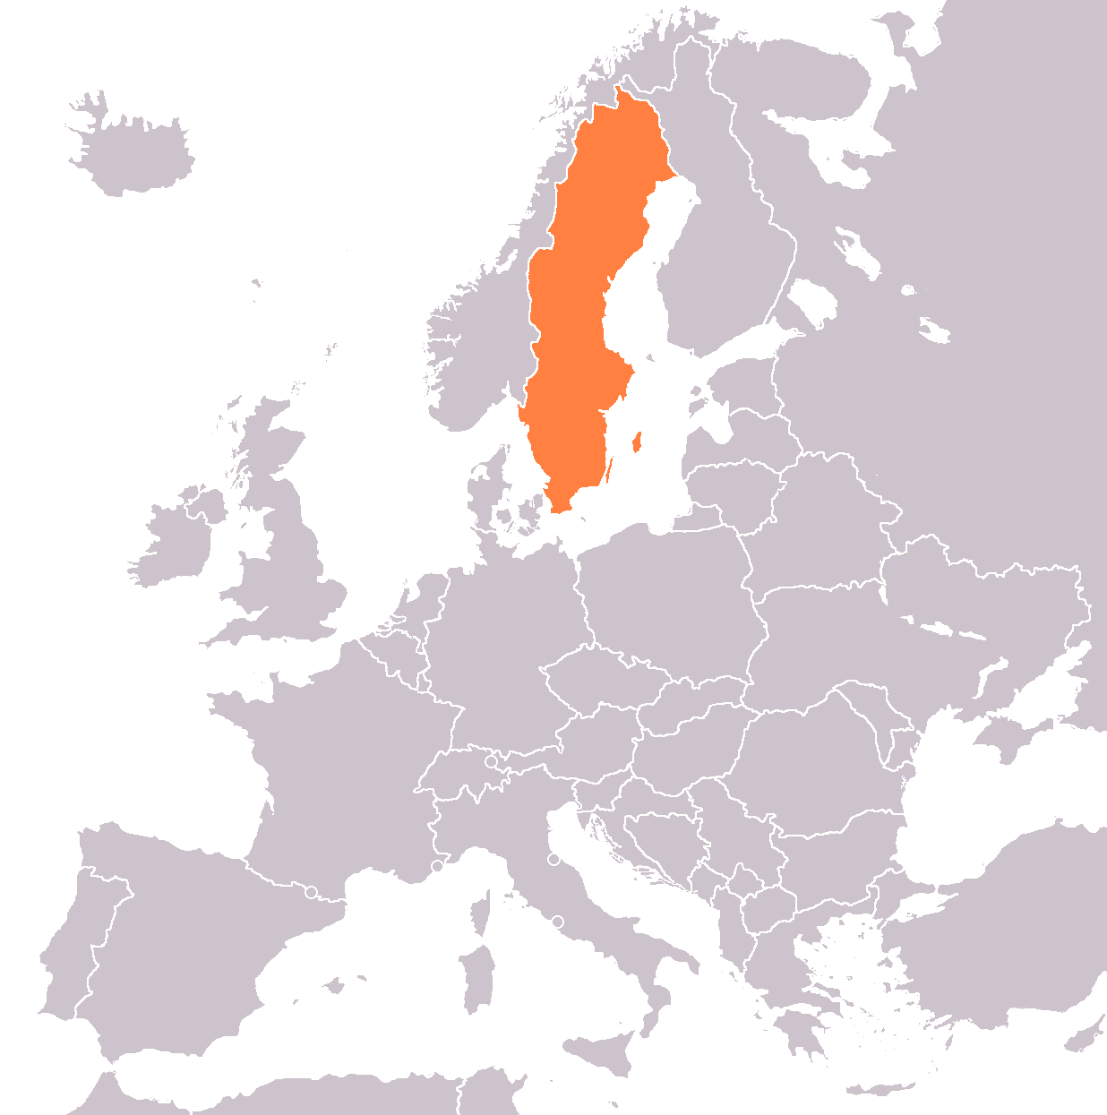
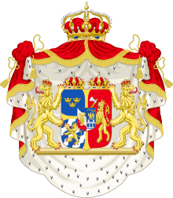
Sweden - in numbers and pictures
:

Slide 3
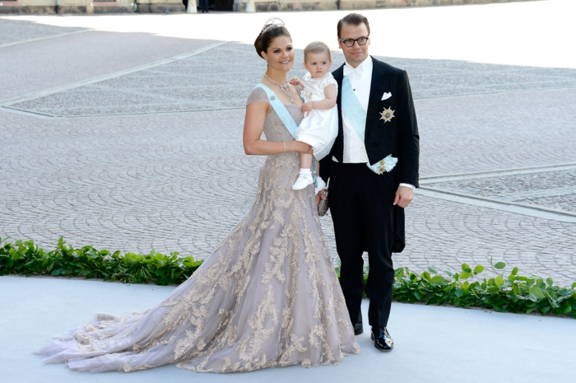
Parliamentary democracy and a constituitional monarchy

Slide 4
Facts:
Inhabitants: 10 million
Area: 5th largest in Europe, only 22 persons/km²
Economy: GNP number 10 in OECD
The Economist’s Democracy Index: Ranked 2nd in the world
We are members in: UN, EU, OECD
We are not members in: European Monetary Union, NATO

Slide 5
Inner Wheel in numbers
9 districts
95 clubs
4 000 members
Average age: 70+
First club: Filipstad IWC founded in Juli 1949.
Youngest club: Gislaved IWC 2002

Slide 6
Membership evolution

Slide 7
Inner Wheel stopped losing members after 2012
Number of new members: around 200 last year
Are we growing?
Disbandment: 2015-16 = 3 clubs
2016-17 = 0 club
2017-18 = 1 club (so far)

Slide 8
New members
2/3 are born in the 1940’s
3/4 not connected to Rotary

Slide 9
Why new members choose Inner Wheel?
Independence!
Religious, political independence and no connection with other organisation
Fantastic service projects
New and interesting friends
They are genuinely interested and have made a consious choice

Slide 10
Social projects
This years contribution grew by 30%!!!!
International project
National projects
Club projects
Scholarships
Objects to buy - surplus to service projects

Slide 11
Happier Futures: Garissa
Home and school for abandoned girls in Garissa, Eastern Kenya
Co-operation with Ekman-stiftelsen
Co-operation with local imams and local midwives against FGM

Slide 12
Garissa: Home and school for abandoned girls

Slide 13
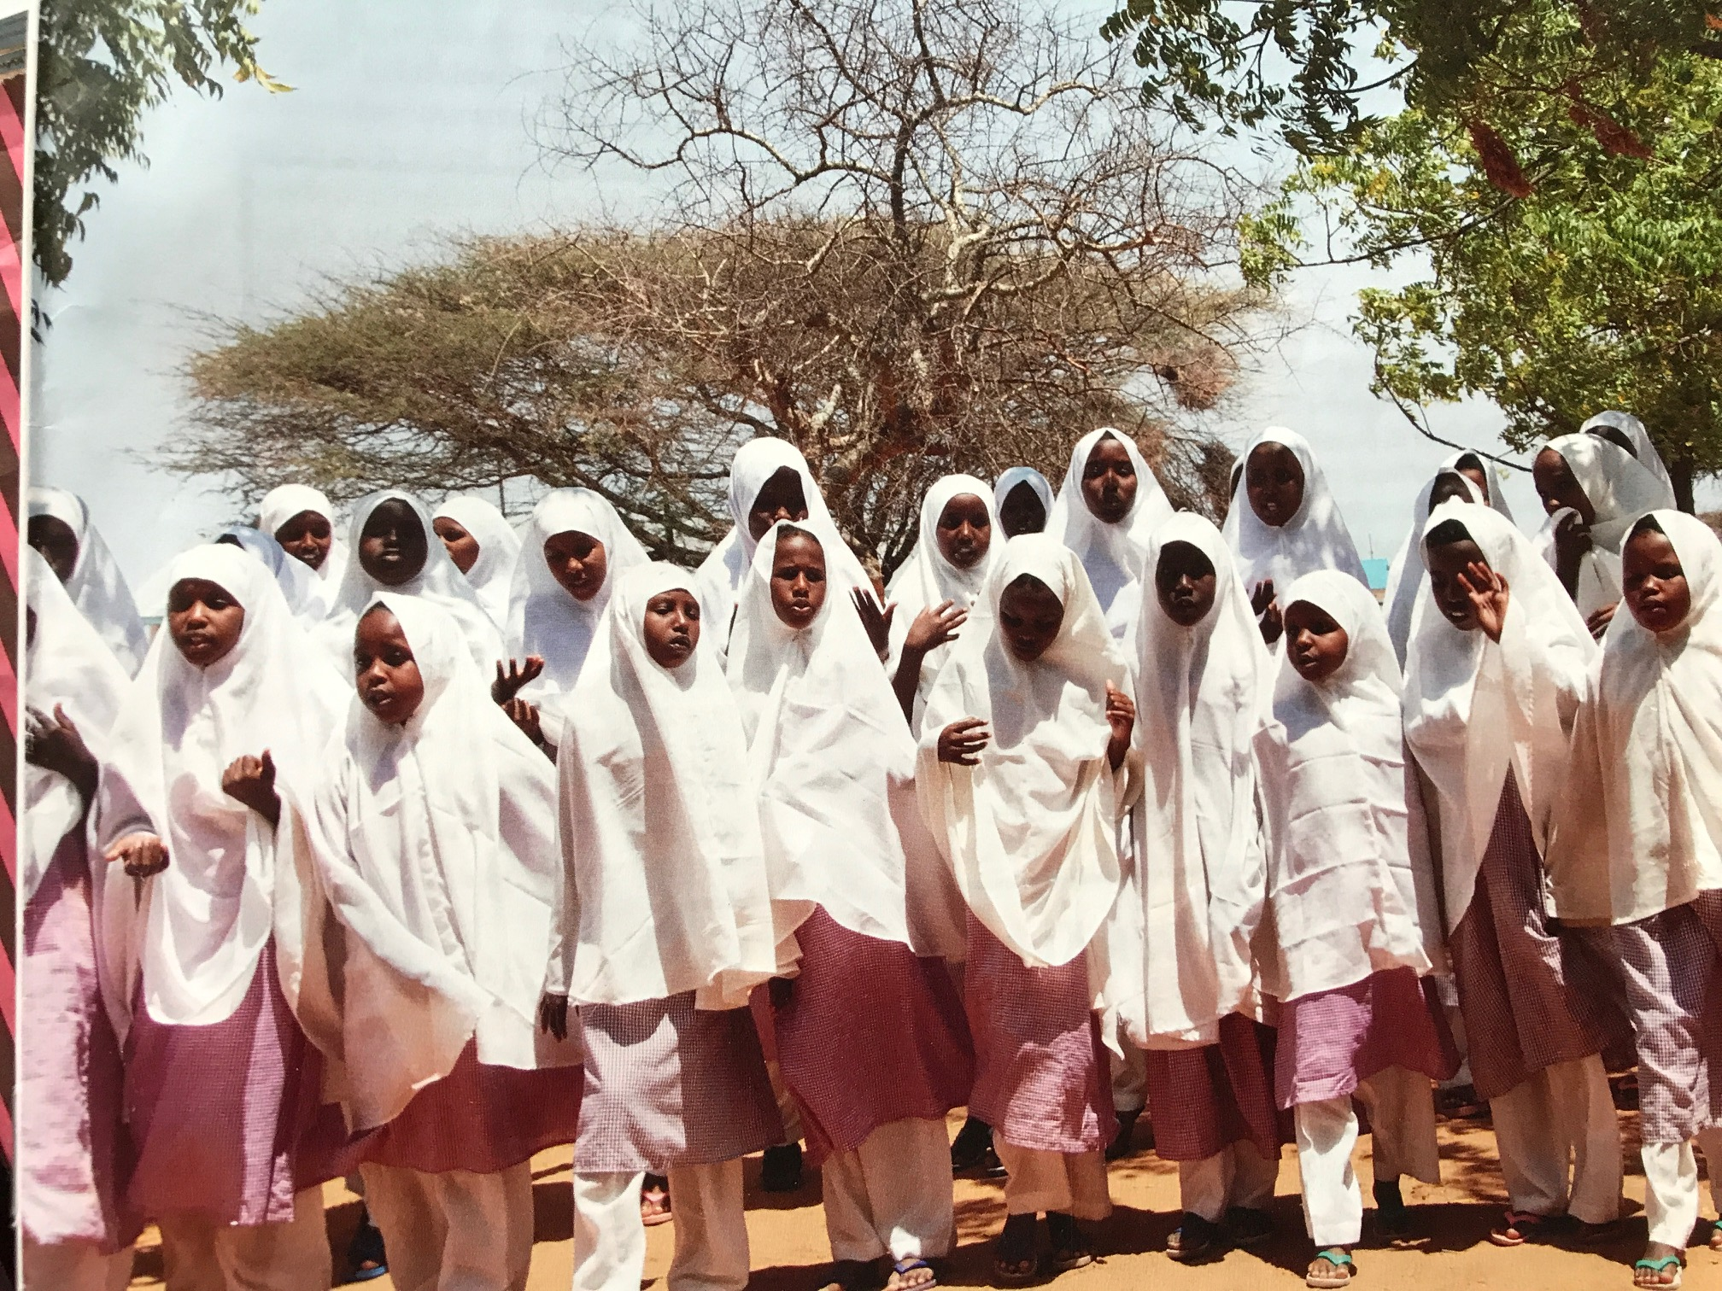

Slide 14
National projects: IW-Doctors
Co-operation with Rotary Doctors Sweden in Kenya
Specialising in pedatrics and female diseases
Clinics and mobile jeep doctors

Slide 15
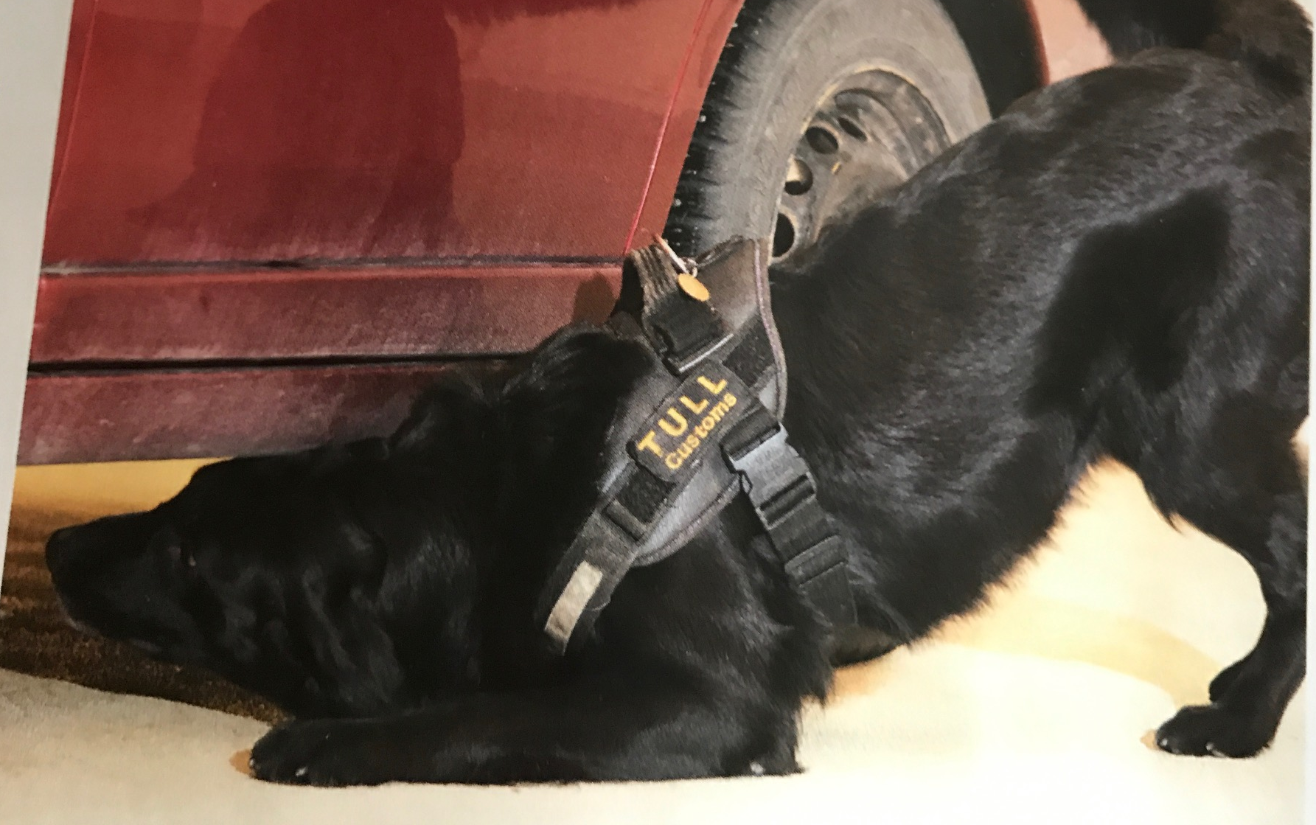
Customs Sniffer dogs One of our national projects

Slide 16
National project: Customs Sniffer dogs
In co-operation with Swedish Customs Department
Ongoing Project for almost 40 years
So far, more than 64 dogs donated
In active service today: 26 sniffer dogs
Last year, Inner Wheel sniffer dogs found narcotics, weapons and ammunition to a value corresponding to € 26 000 000!
Customs Dog of the Year:
Almost always an Inner Wheel dog, gives national newspaper coverage

Slide 17
Club projects
Actually generating more than our international and national projects
Local projects: vagrants, shelter for abused women, shelters for young girls/women threatened by crimes of honour
Practical help to immigrants
Support to projects abroad: orphanges, schools , hospitals, organisations like Smile etc

Slide 18
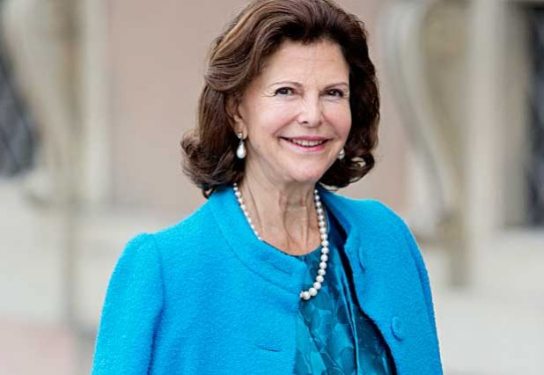
Scholarships
Scholarship to students studying at Queen Silvia Foundation for Further Education of Nurses and Assisting Nurses in the field of dementia diseases.
Two scholarships every year

Slide 19
Communication
Brand new website: modern and easy to navigate
Every district and all clubs have websites since many years
Our paper: IW-Nytt, four editions every year, also on website

Slide 20
Meetings
Nordic Rallies – every 3rd year – last time Skagen, Denmark in 2016
Bridging the Baltic Sea – environmental international meeting – every 3rd year- countries with coastline to the Baltic Sea –last time in Kalmar, Sweden in 2016
Friendship meetings – district undertaking – every 3rd year
Information meeting/kick-off – for district officials – every year in August – to inform, groom the special officials, give them a net work and fill them with pride and joy
Under my year as National President, we introduced the possibility to borrow up to € 1000 to plan and prepare larger meetings open for all members

Slide 21
Documents:
For sale:
IW Post Cards with IW rose: surplus goes to Silvia Nurses´ Scholarships
Magnetic book mark: with IW info in Swedish and English, surplus goes to combatting FGM in Garissa, Kenya
For distribution:
Leaflets: four folded

Slide 22
Not yet back where we would like to be but advancing….

Slide 23
Thank you,
Welcome to Sweden!

